Slide 1
SoCalREN Q3 2025 Regional Workforce Alliance Meeting
September 17, 2025
Orange Coast College, Costa Mesa, CA

Slide 2

Agenda
11:30 AM - 12 PM - Networking Lunch
12 PM - 1:30 PM - Welcome, Presentations, and Discussion
Welcome - Minh Le, General Manager, Energy and Environmental Services, County of Los Angeles, SoCalREN
Moderator’s Welcome: Tessa Charnofsky, Special Services Assistant, SoCalREN
Featured Discussion - SoCal's Clean Energy Future: Overcoming Challenges and Moving Workforce Development into Action
Keynote: Bob Keefe, E2
Expert Panelists: Nataly Morales (OCPA); Jeremy Zeedyk (SMART); Robyn Mancell (Green Energy Solutions)
Program Spotlight - Orange Coast College, Teva Crowley, Faculty
Closing Remarks - Ben Stapleton, USGBC-CA
1:30 PM - 2 PM Networking
2 PM - 2:30 PM Optional Tour - Orange Coast College Technology Center

Slide 3
Featured Discussion:
SoCal's Clean Energy Future
Overcoming Challenges and Moving Workforce Development into Action

Slide 4
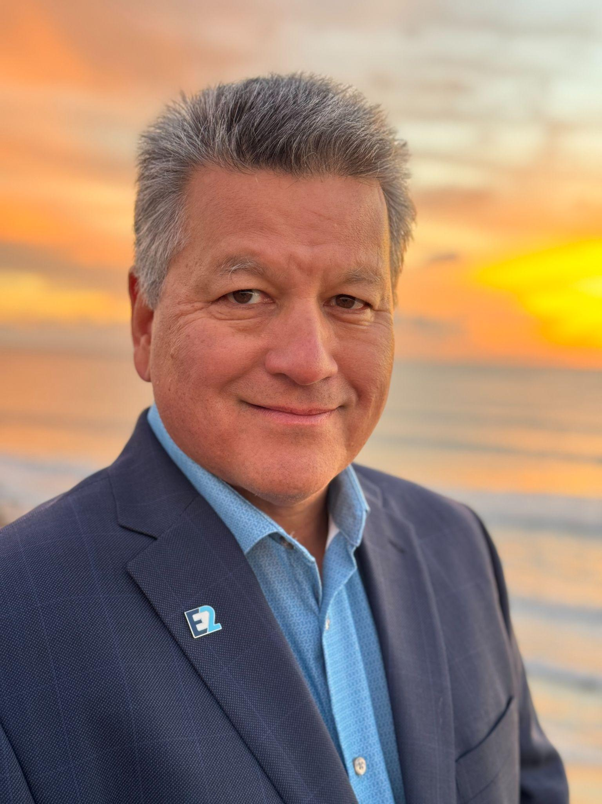
Bob Keefe
Executive Director, E2
Bob Keefe is executive director of E2, a national nonpartisan organization of more than 11,000 business leaders who advocate for policies that are good for our economy and our environment. Bob has testified before Congress and numerous state legislatures about clean energy and the clean economy, and is the author of two books on clean energy and the economics of climate change: “Climatenomics: Washington Wall Street and the Economic Battle to Save Our Planet” “Clean Economy NOW: Stories from the Frontlines of an American Business Revolution”.

Slide 5
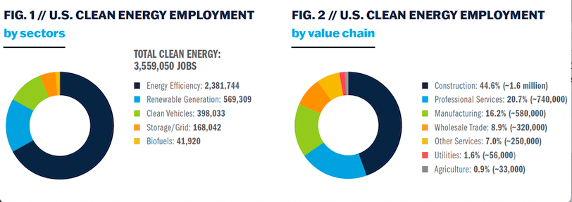
Clean Jobs America 2025 cleanjobsamerica.e2.org/

Slide 6
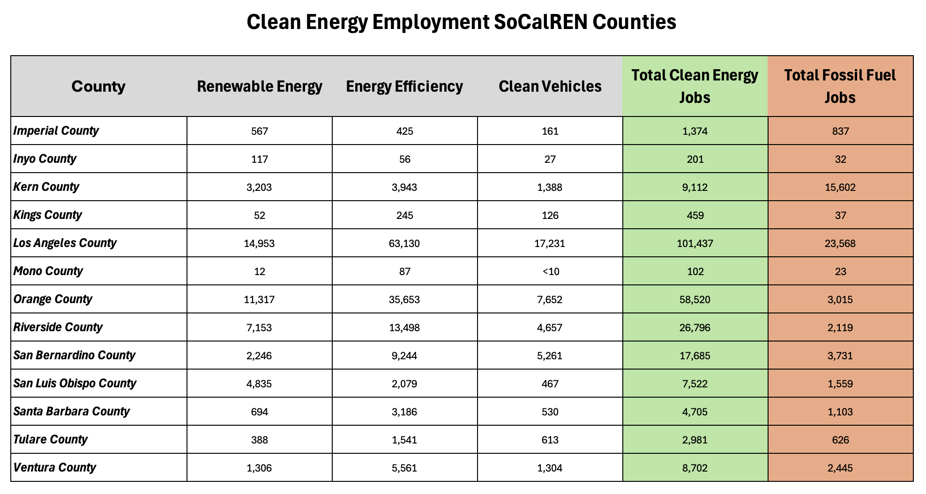
Clean Jobs America 2025 cleanjobsamerica.e2.org/

Slide 7
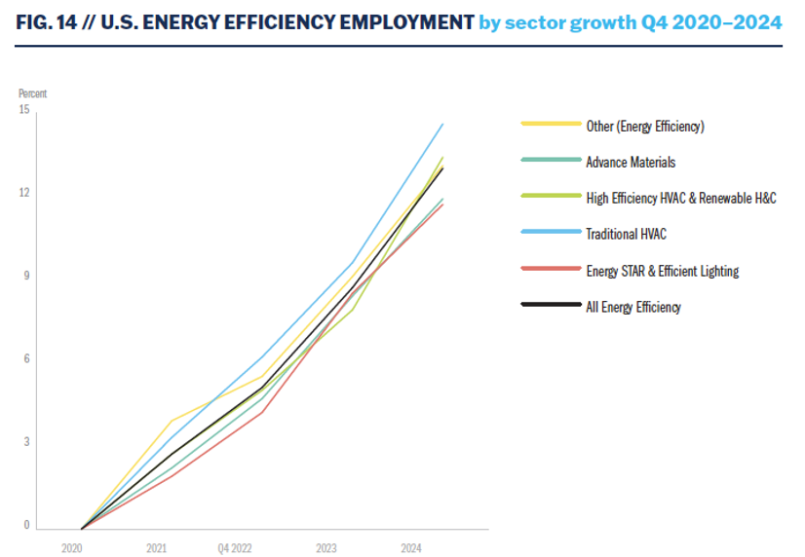
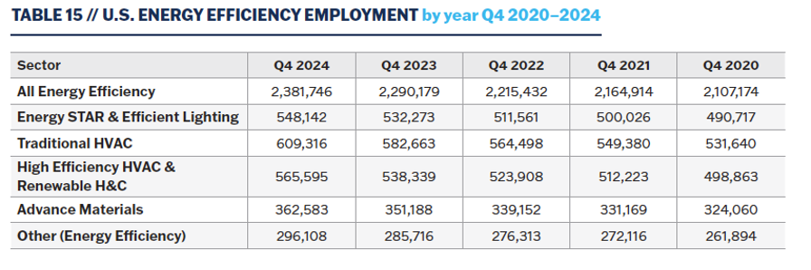
Clean Jobs America 2025 cleanjobsamerica.e2.org/
Energy Efficiency Jobs
2.4 M nationally (+2 %)
312,000 California (+3 %)
138,500 SoCalREN
HVAC, HE HVAC growing fastest

Slide 8
Q&A

Slide 9
Meet the Experts!
Keynote:
Bob Keefe - Executive Director, E2
Panelists:
Nataly Morales Sandoval - Energy Programs Analyst, Orange County Power Authority
Jeremy Zeedyk - Workforce Development Specialist, Sheet Metal, Air, Rail, and Transportation Workers (SMART)
Robyn Mancell - CEO, Green Energy Solutions Holdings

Slide 10
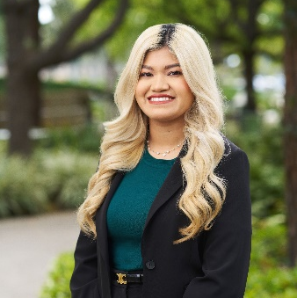
Nataly Morales Sandoval
Energy Programs Analyst
Oversee community benefits at OCPA and track success
Includes community grants and customer programs
Previous experience includes the Los Angeles Cleantech Incubator supporting workforce development
Masters Degree from University of California, Riverside in Public Policy Urban Planning
Notes:
My name is Nataly Morales Sandoval and I am the Energy Programs Analyst at Orange County Power Authority or OCPA for short working on Customer Programs such as rebates, discounts, and grant programs for OCPA customers. I got my Masters in Public Policy at the University of California, Riverside where I've worked with various not-for-profits and local and federal government level. Most recently, worked on various pilot programs in building and transportation electrification at Los Angeles Cleantech Incubator and worked under the Workforce Development team and saw closely the various cohorts hosted in Los Angeles which I would love to bring those lessons and understandings to the Orange County Region alongside OCPA's priorities. Which now I want to share a bit more about OCPA's background.

Slide 11


Mission
Provide the option of renewable energy at competitive rates and equitably reinvest to support sustainable communities.

Slide 12

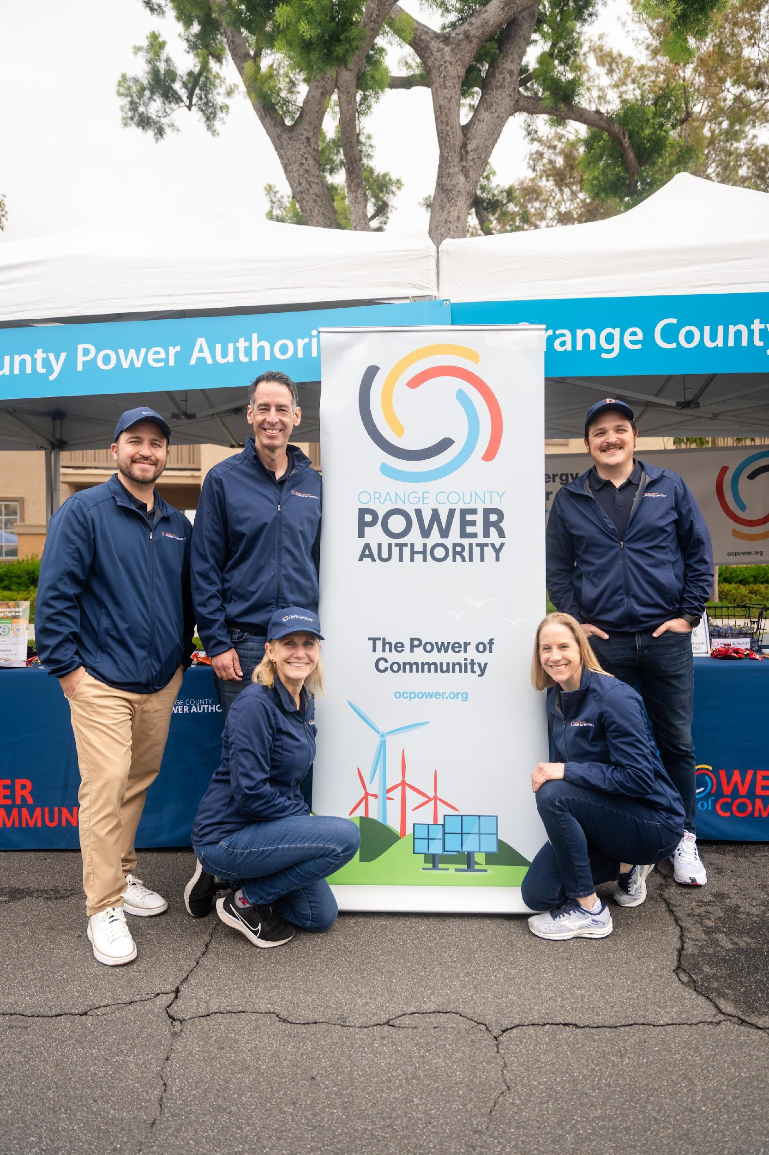
About Orange County Power Authority
(OCPA)
OCPA is a not-for-profit Community Choice Aggregation (CCA) agency that provides residents and businesses choice in their electricity provider, and allows for local control.
CCAs also focus on procuring renewable energy, with the goal of reducing carbon emissions and helping customers make the clean energy transition.
Launched residential service in October 2022.
Office located in Irvine with 21 full-time staff.
Serving over 198,000 customers in the cities of Buena Park, Fullerton, and Irvine – and Fountain Valley in Oct 2026.

Slide 13
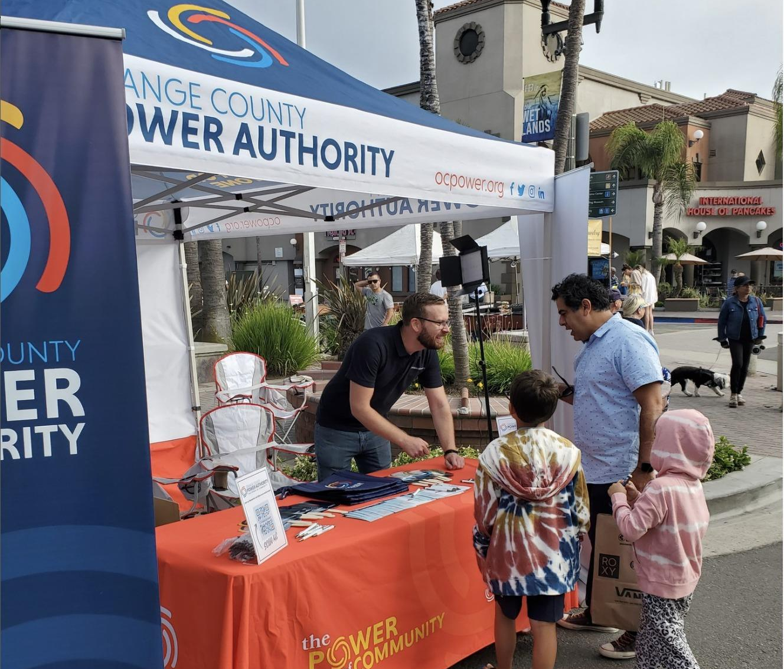
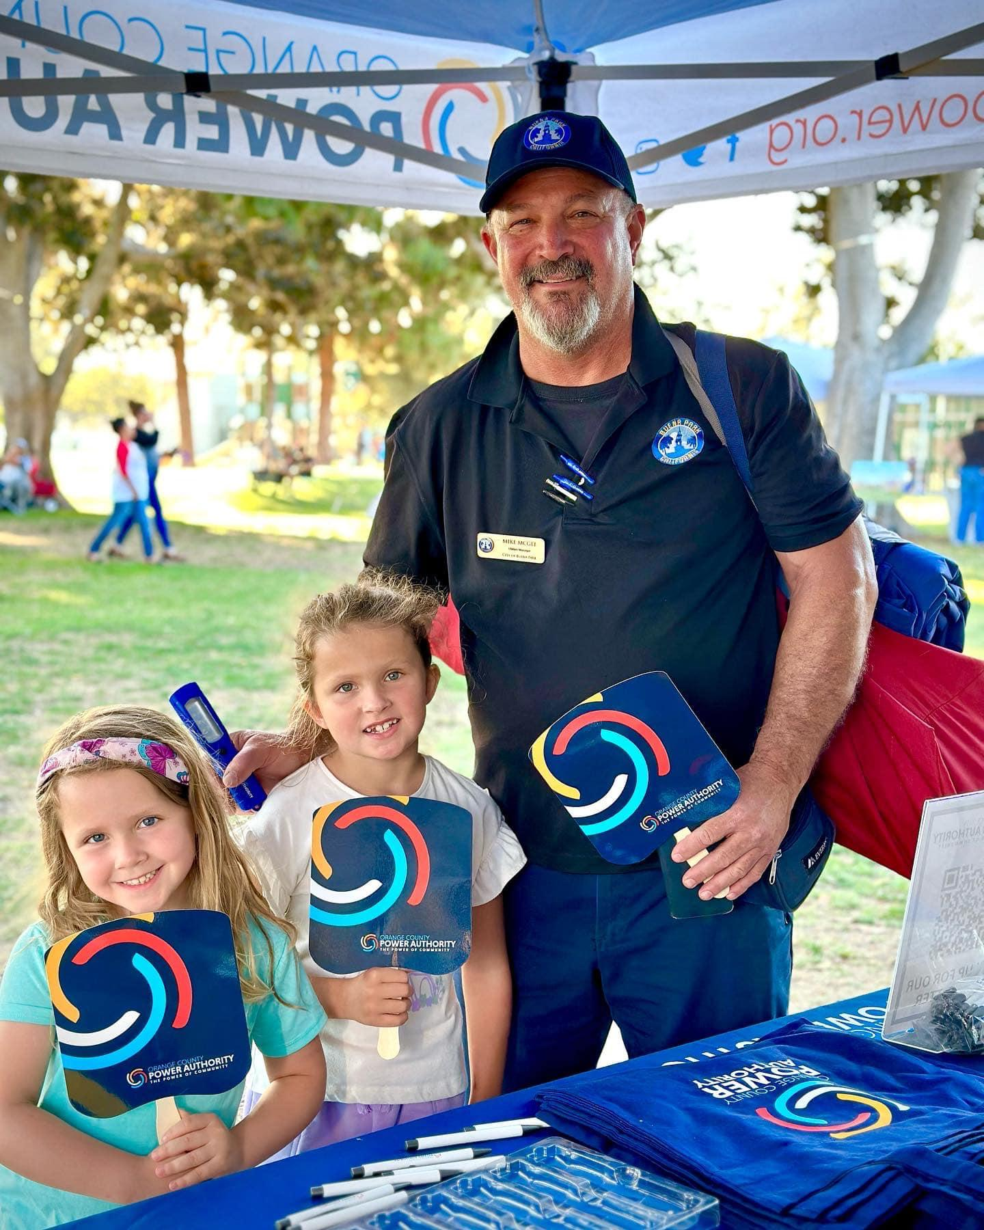
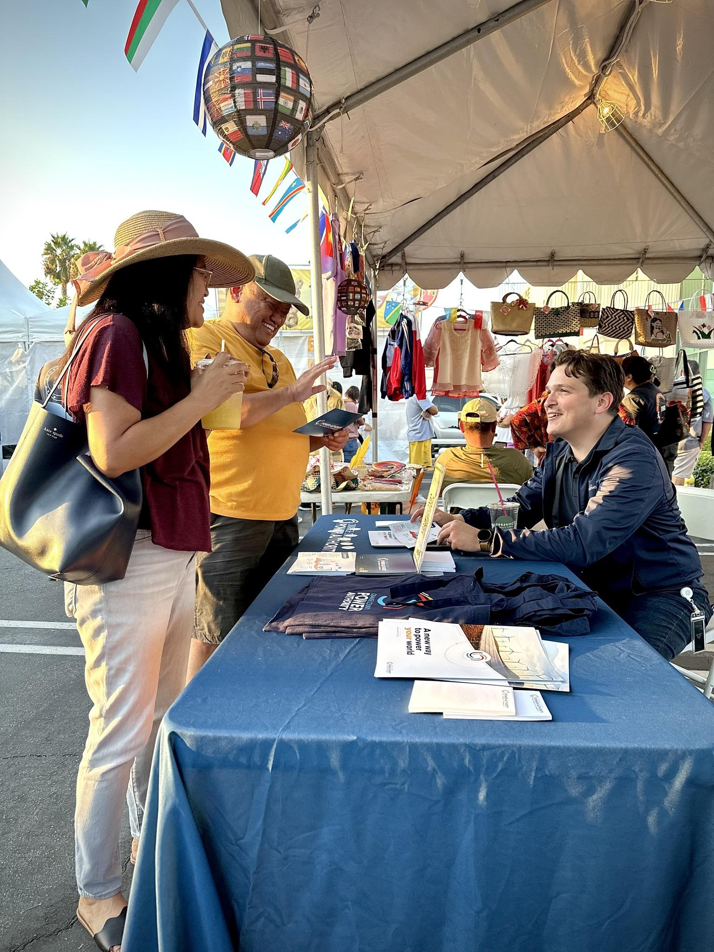
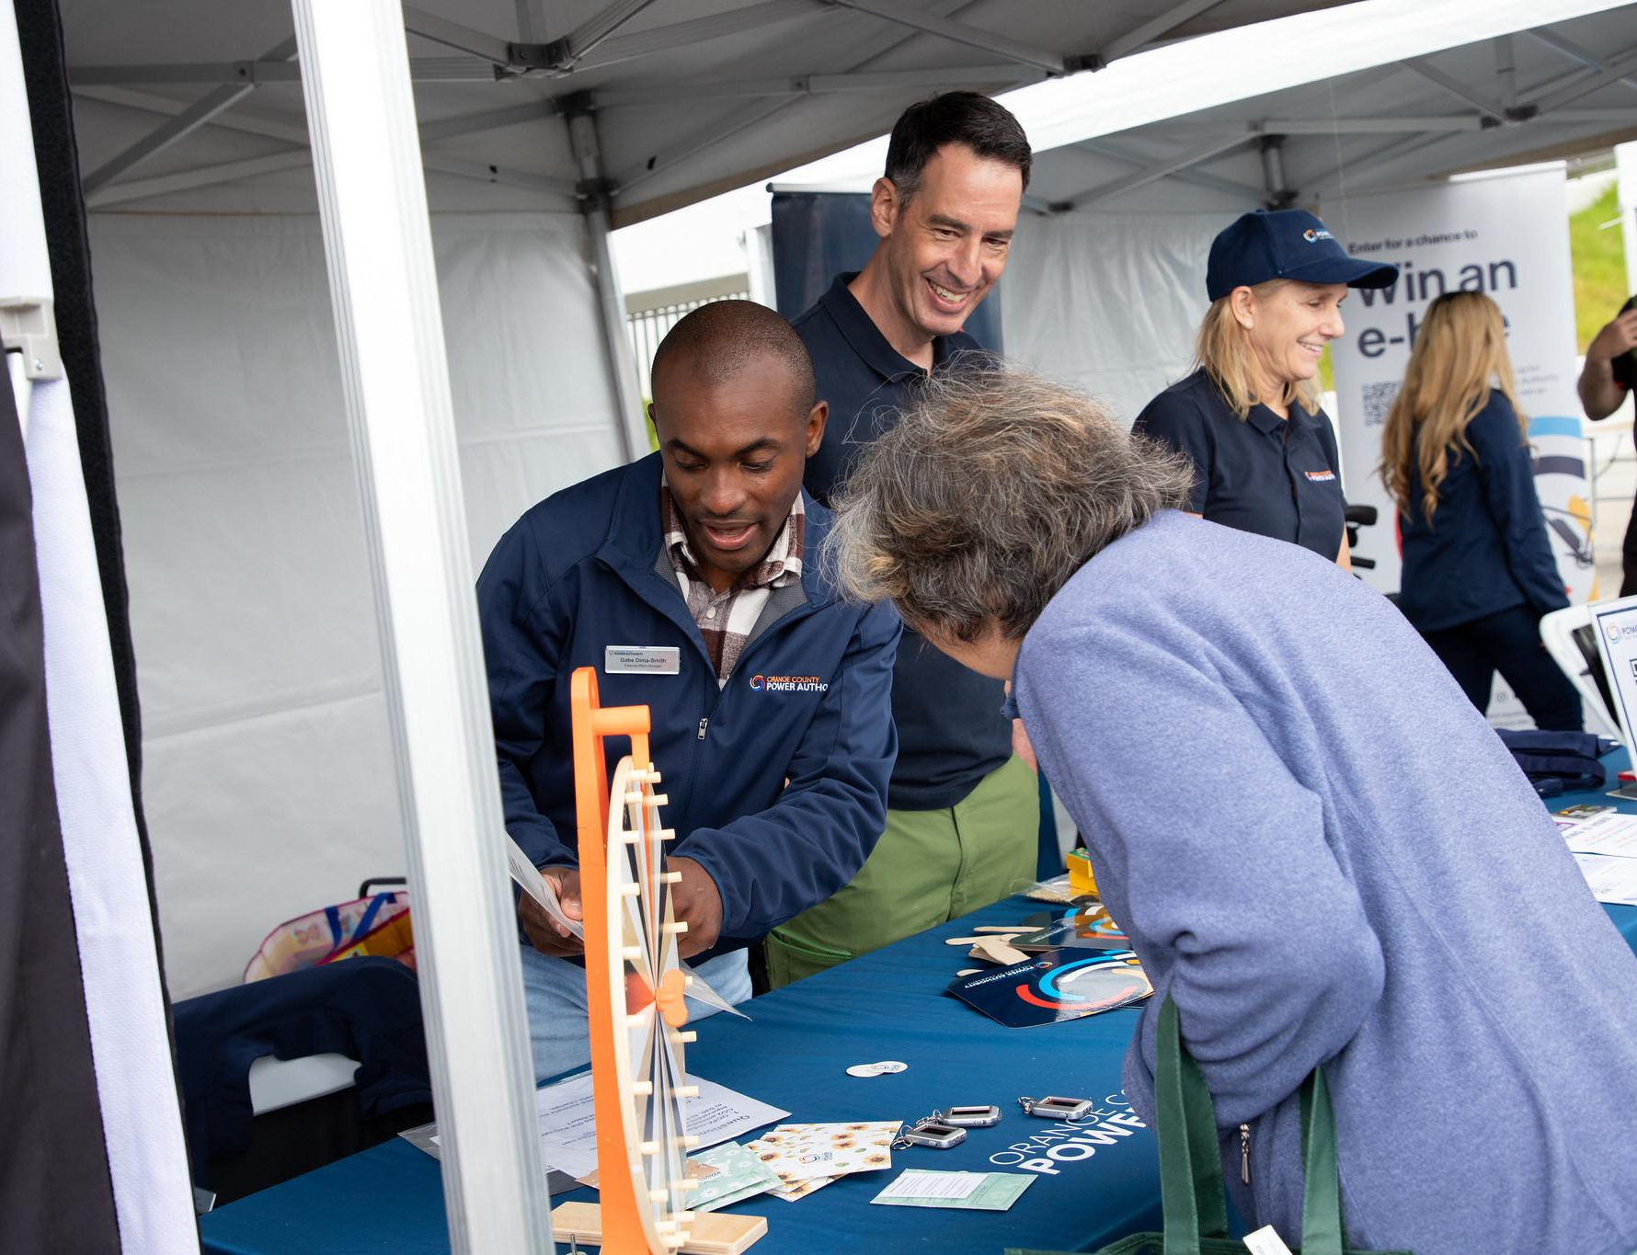
Strategic Goals & Policies
Enrich & Grow the OCPA Community
Develop educational tools and programs that promote renewable energy for students of all ages, including school partnerships, curriculum support, internship program, youth ambassador program, and community academy.
Sustainable Workforce Guidelines
Job Quality Standards
Apprenticeship and Training Programs
Local and Targeted Hire
Labor Engagements
Inclusive Practices
Alignment with State Policy Goals

Slide 14
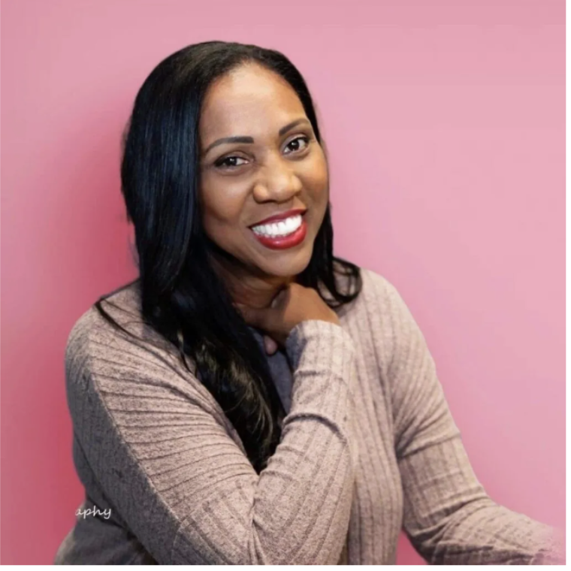
Robin Mancell
CEO, Green Energy Solutions Holdings
Robyn Mancell is a renewable energy entrepreneur and sustainability advocate with over 15 years of corporate and entrepreneurial experience. As the CEO of Green Energy Solutions Holdings and Chair for the USGBC-CA Inland Empire Committee, her mission is to accelerate the adoption of renewable energy. She achieves this by providing cost-effective solutions like solar and EV chargers for residential and commercial clients, with a strong focus on empowering the Inland Empire community through education.
A dynamic public speaker, Robyn excels at fostering connection and inspiring collaborative action around sustainability.

Slide 15



Building Energy Entrepreneurship
Energy Modeling
Energy Audits
AI and Energy Efficiency
High School Workshops
Marketing Skill Development

Slide 16
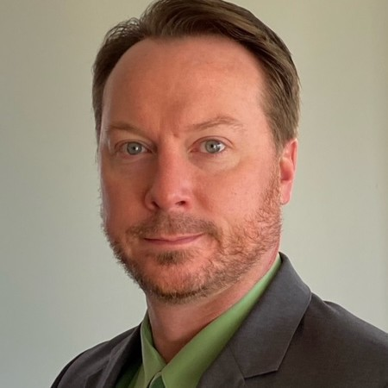
Jeremy Zeedyk
Western States Council of Sheet Metal, Air, Rail, and Transportation Workers (SMART)
Jeremy Zeedyk is the Grant Administrator and Special Projects Coordinator for the
Western States Council of SMART (WSC) and has been in that role since 2024 where
he administers a $5.7 million Department of Energy Industrial Training and Assessment Grant and works with SMART Local Unions on codes and standards issues and local ordinances and legislation.
Prior to joining the WSC, he served as the Northeast Representative for the National
Energy Management Institute (NEMI) for 3 ½ years promoting specialized portions of
the sheet metal trade, including Fire Life Safety, Indoor Air Quality, and Testing,
Adjusting and Balancing. At NEMI Jeremy consulted and served as a subject matter
expert for over a dozen states on Fire Life Safety and IAQ legislation as well as working with various Federal agencies and the White House during the COVID pandemic and its aftermath.
Jeremy was a sheet metal apprentice in Connecticut where he specialized in testing,
adjusting, and balancing in the field for over 7 years, working on all sizes of projects
throughout the Northeast. He also held several roles as a local sheet metal union
representative in Connecticut, including Instructor, Organizer, and Business
Representative from 2007 to 2017.

Slide 17

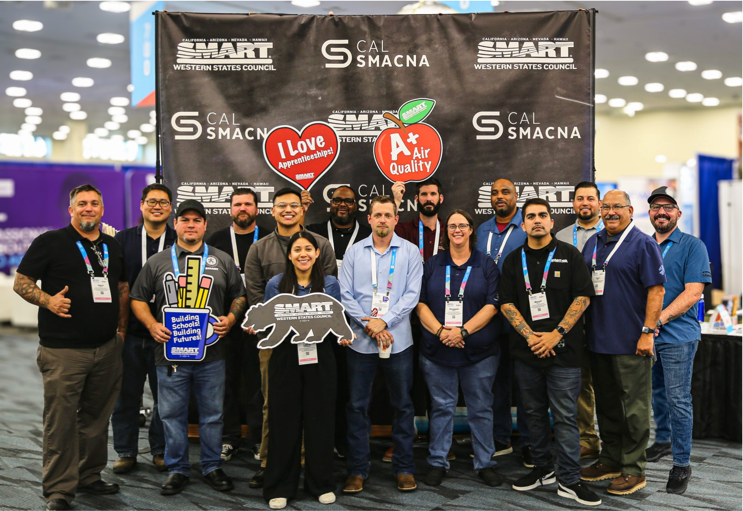
SMART is the HVAC Union
Who we are:
20,000 Skilled Technicians
Fabricate, install, test, and service
What is a union:
Group of workers
Wages, safety, compliance
Apprentice Training & Education:
Self-funded
System Understanding
Continued Education
Industry & Policy Leadership:
Codes and Standards
Legislation and Ordinances
Built Environment Safety and Efficiency

Slide 18
Panel Discussion

Slide 19
Program Spotlight - Orange Coast College

Slide 20
Closing Remarks - Melanie Peck

Slide 21
Thank You!

