Slide 1
SoCalREN Q2 2025 Regional Workforce Alliance Meeting
June 4th, 2025
SCE Energy Education Center, Tulare, CA

Slide 2

Agenda
12 PM - 1:15 PM - Welcome, Presentations, and Discussion
SoCalREN’s Vision for Workforce, Education, and Training - Lujuana Medina, Environment Initiatives Division Manager, SoCalREN, County of Los Angeles
Moderator’s Welcome - Shelley Osborn, Program Manager at SoCalREN
Featured Panel - Connecting the Energy Efficiency Workforce - Creating Job Opportunities in Energy Efficiency Through Training
Program Spotlight - Southern California Edison (SCE) - Patty Flores and Lionel Moreno, Mobile Education Unit Program in the Central Valley
1:15 PM - 1:30 PM - Topic Breakouts and Closing Remarks - Lujuana Medina, SoCalREN
1:30 PM - 2:00 PM - Optional Tour - SCE Energy Education Center

Slide 3
SoCalREN’s Vision for Workforce, Education, and Training
Lujuana Medina - SoCalREN

Slide 4

Lujuana Medina
Environmental Initiatives Division Manager - SoCalREN, County of Los Angeles
Lujuana is responsible for managing and operating environmental initiatives programs administered by the County of Los Angeles. This includes the Southern California Regional Energy Network (a portfolio of energy efficiency programs) and the SoCal EVen Access (a portfolio of EV infrastructure programs). Additionally, she leads policy and grant development regarding energy efficiency, distributed energy resources, clean energy programs, and the electrification of transportation. Over the past 15 years, she has worked in a variety of capacities within the energy industry. Before joining the County of Los Angeles, Lujuana served as the Energy Policy & Regulatory Manager as a consultant for various clients, as the Energy Efficiency Policy Lead Advisor for Southern California Gas Company, as a Regulatory Case Manager in the Power Procurement Department for Southern California Edison, as a Generation Resource Planner and Utility Finance Advisor for San Diego Gas & Electric.

Slide 5
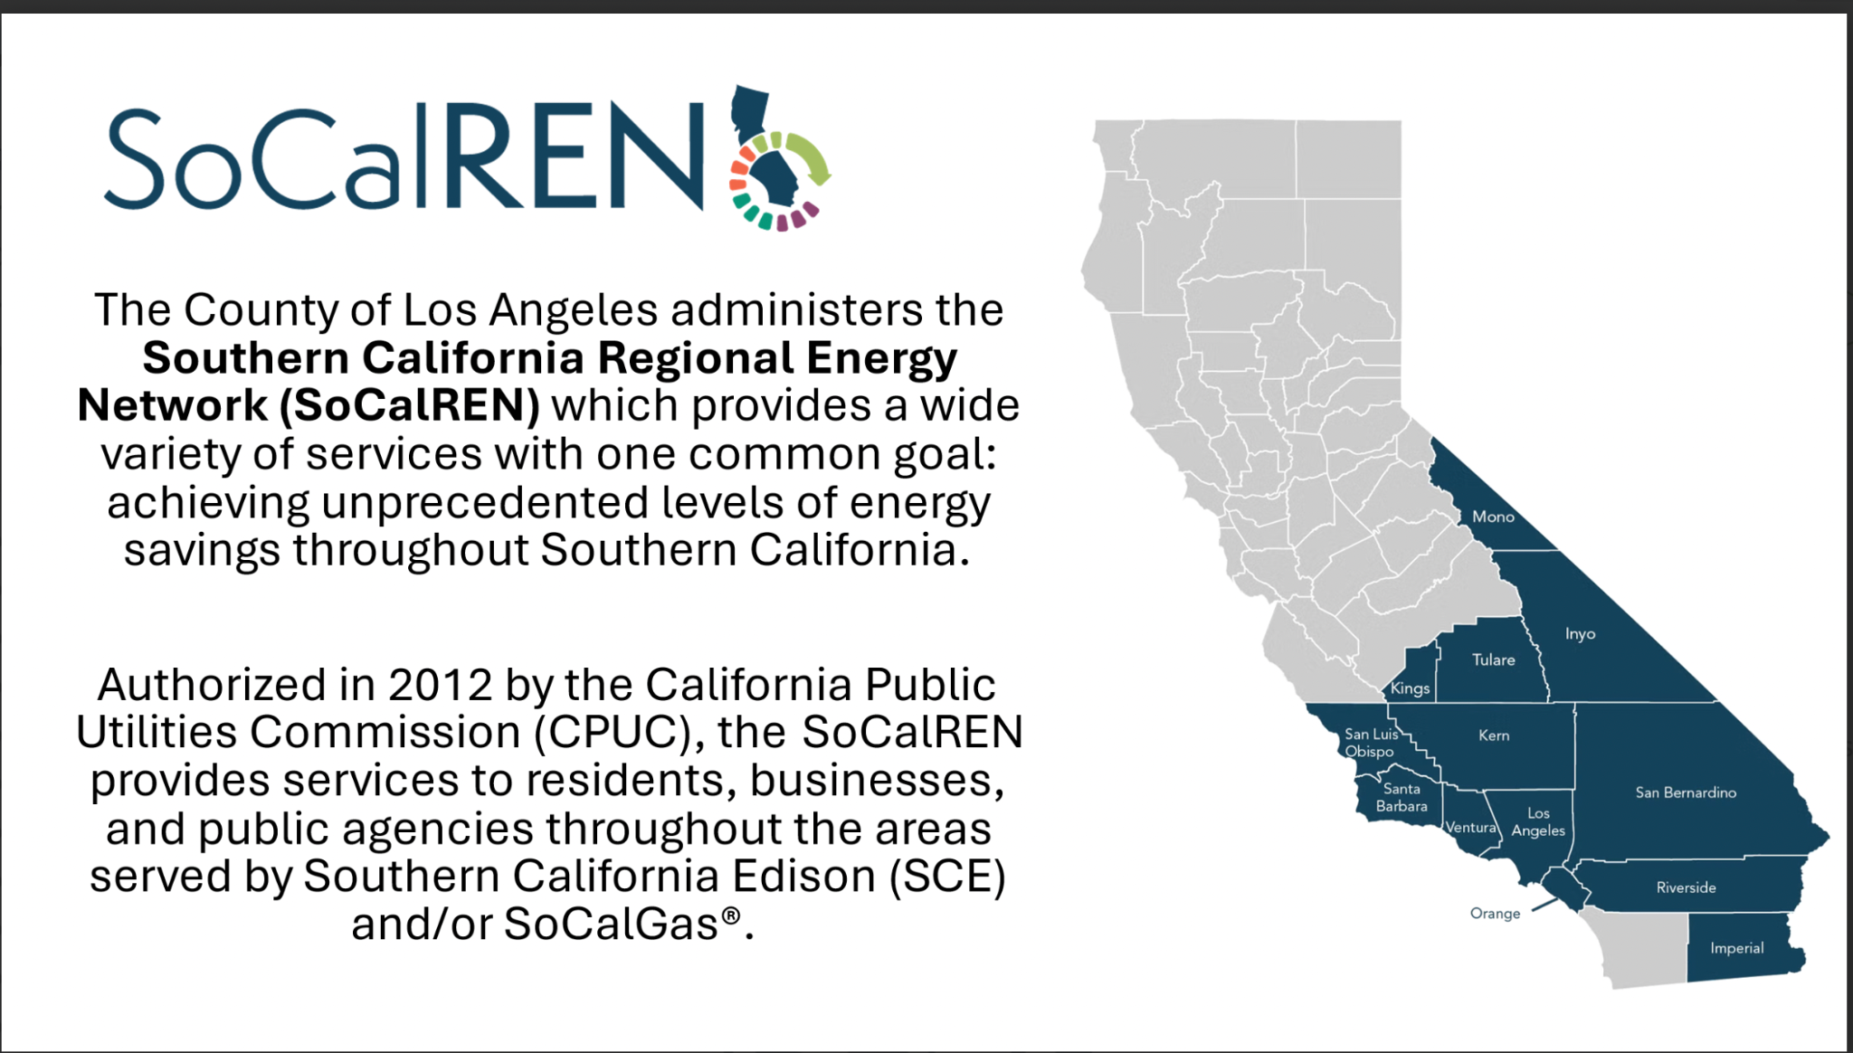

Slide 6
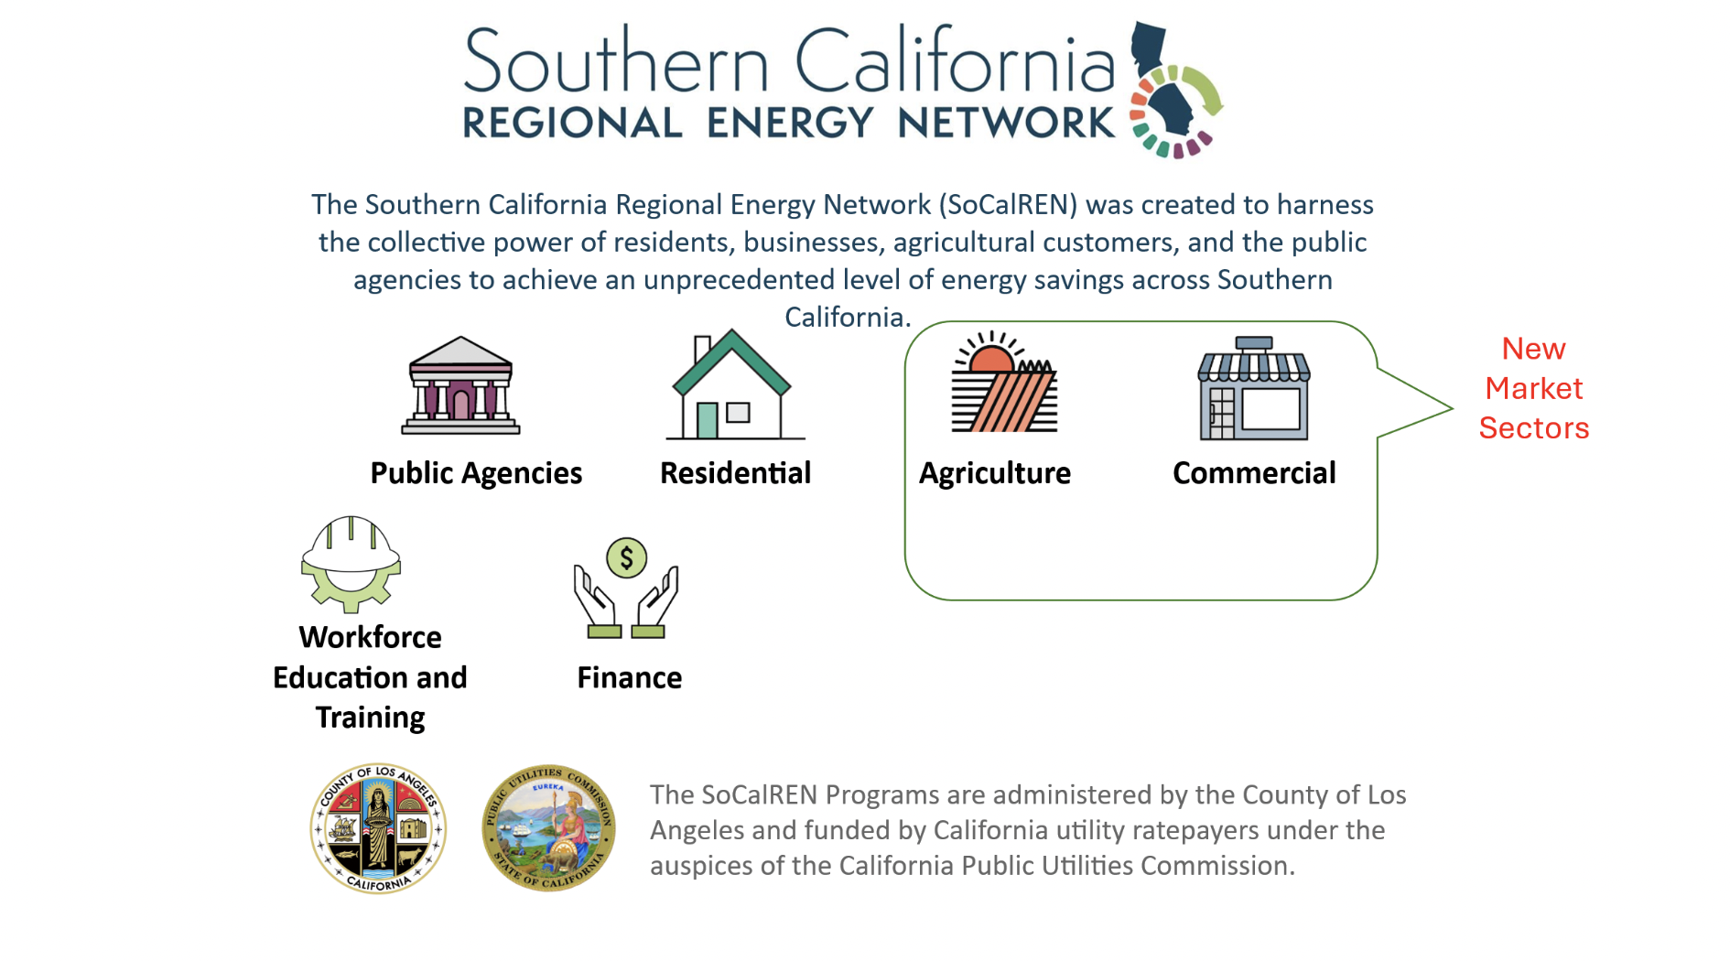

Slide 7
Featured Panel:
Connecting the
Energy Efficiency Workforce
in the Central Valley
How Energy Efficiency Training Programs Lead to Jobs and Shared Community Benefits

Slide 8
Meet the Panelists - Connecting the EE Workforce
Rosie Kang, Regional Partner Liaison, Willdan - Developing Workforce Solutions for Small Commercial Enterprises, Food Deserts, and Business Energy Advisors - Willdan Clean Energy Academy - SoCalREN Commercial Programs
Samuel Cervantes - Account Manager - Agricultural Energy Efficiency (AgEE) Programs, ICF - Opportunities for Energy Efficiency Careers through Agricultural Programs - SoCalREN Agricultural Programs
​Wendy Angel - SoCal Regional Director at Emerald Cities Collaborative - E-Contractor Training Program and Opportunities for Skilled Trades - SoCalREN WE&T Programs
Jason Crow - Manager of Heavy Duty Energy Efficiency Rebate Programs, California Air Resources Board (CARB) - Clean Energy Jobs Critical to Improved Air Quality in the Central Valley - Energy Efficiency and Air Quality Nexus

Slide 9
Rosie Kang, Willdan - Developing Workforce Solutions through SoCalREN for Small Commercial Enterprises, Food Deserts, and Business Energy Advisors
Willdan Clean Energy Academy

Slide 10
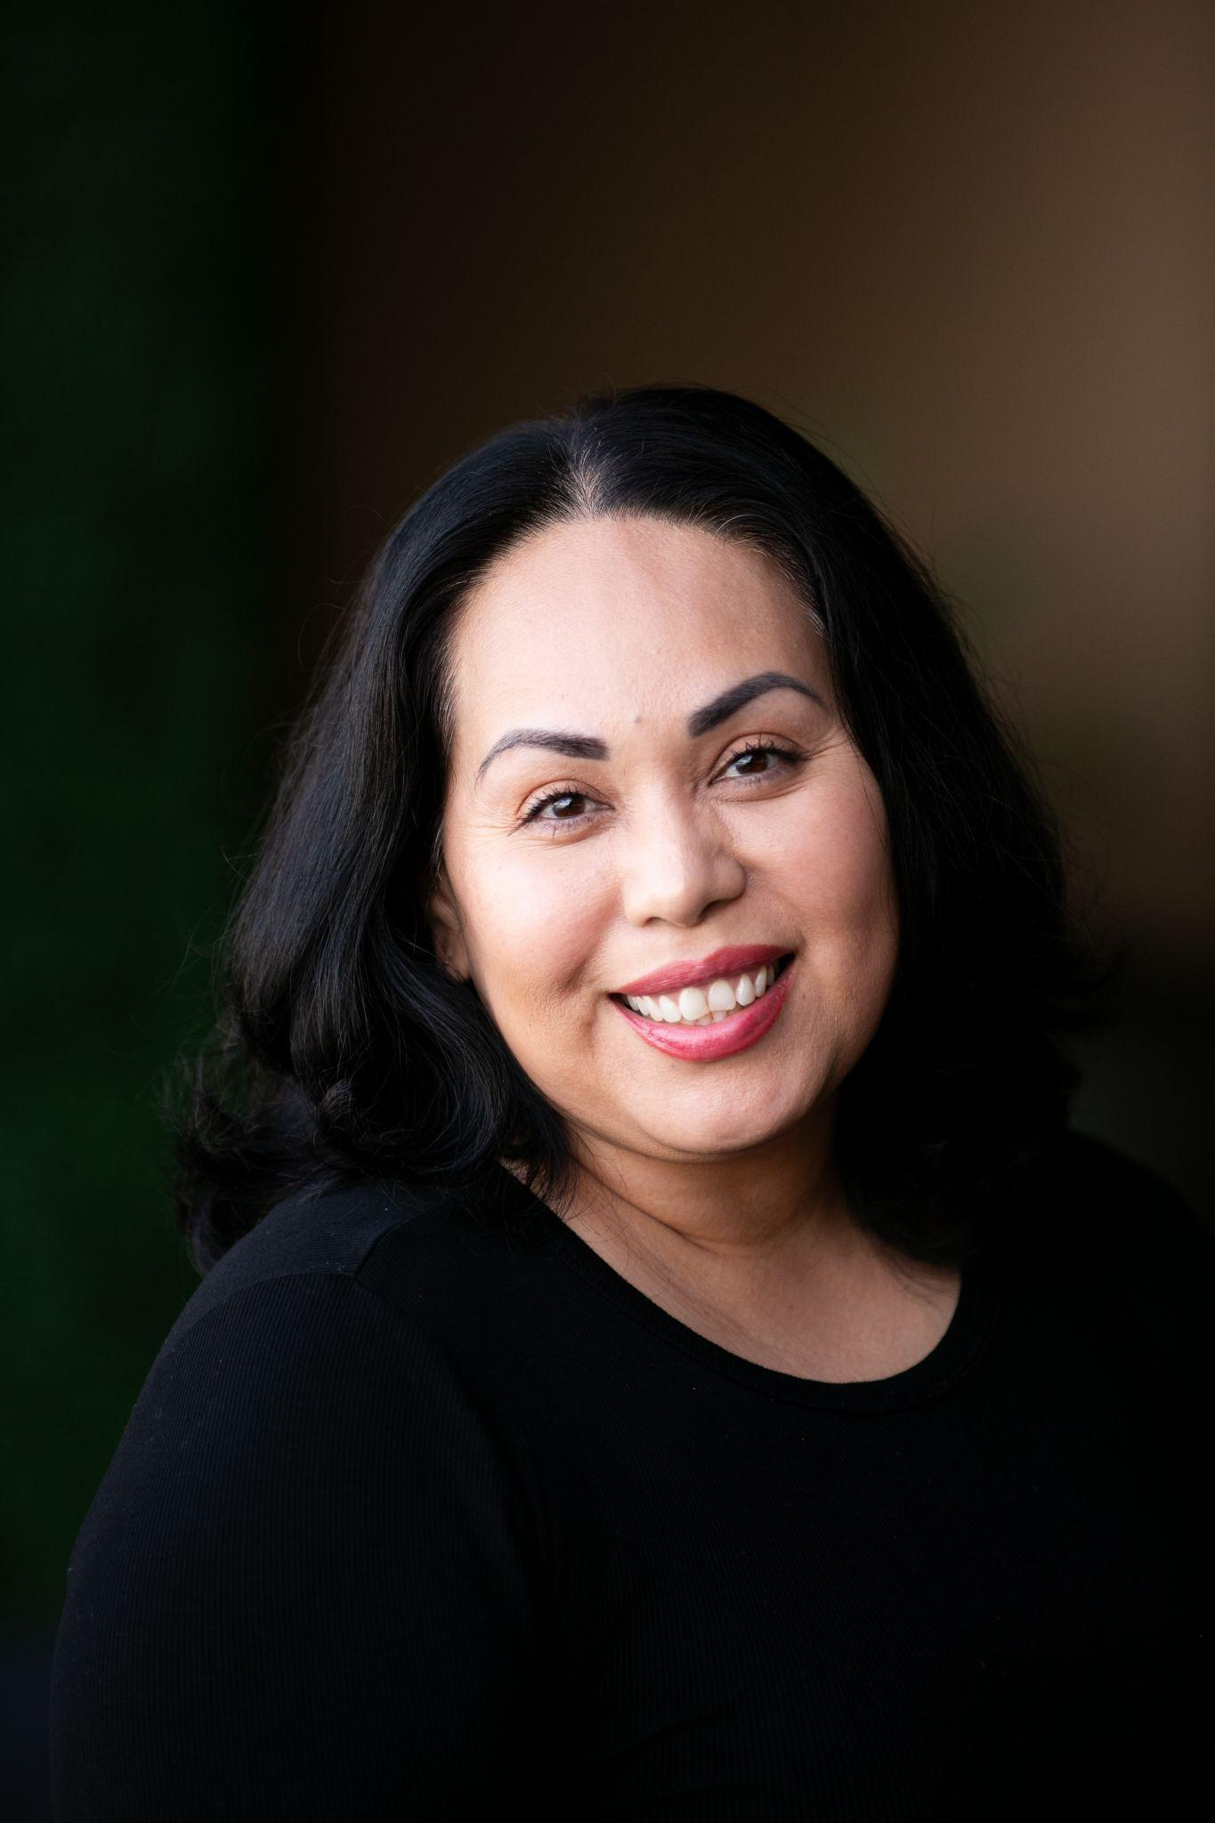
Rosie Kang, Willdan
Regional Partner Liaison
Rosie Kang, is Regional Partner Liaison for the SoCalREN Commercial Portfolio working closely with key stakeholders, ensuring successful program rollout and sustained community engagement. She supports the portfolio’s community-based organizations partners and outreach strategy deployment.
An energy efficiency specialist with seventeen years of experience partnering with local governments to advance sustainability initiatives. Specializing in implementing comprehensive programs that deliver measurable results while aligning with agency goals and sustainability targets.

Slide 11

SoCalREN Commercial - Three Programs, One Integrated Approach
Food Desert Energy Efficiency Equity
HTR, DAC and LILA
No-cost technical services
Identifies an anchor store in a designated Food Desert where we can install new refrigeration equipment and implement energy efficiency upgrades
Enables business to offer fresh food to their community
Hard-to-Reach Commercial Direct Install
HTR, DAC and LILA
No-cost technical services
Similar to FDEEE, implements energy efficiency upgrades
No refrigeration measures

Slide 12
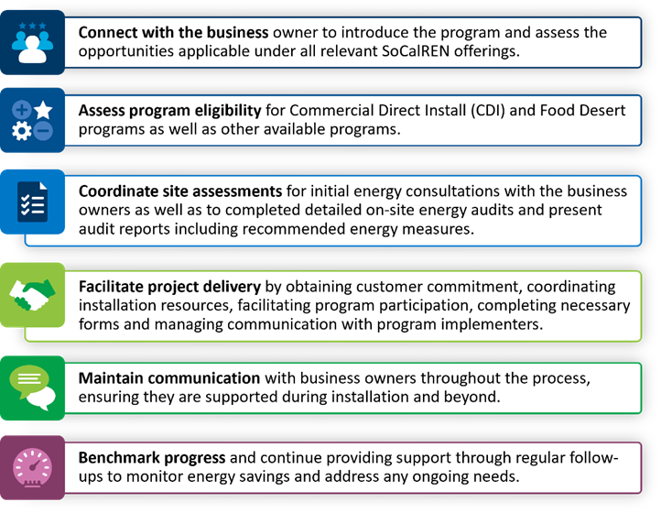
Hard-to-Reach Business Energy Advisor
Designed to reduce barriers to energy efficiency actions and program participation in the SoCalREN territory for hard-to-reach businesses by providing in-community, direct to participant energy efficiency support.
In-community partners assist in targeting individual commercial facilities
BEA’s conduct in-person visits to make serves available
In-community organizations and trusted stakeholders encourage participation
Energy Advisors support participation in energy efficiency programs and increase knowledge

Slide 13


In-Community Partners - Hiring Business Energy Advisors
The Rural Prosperity Center (RPC) stands at the forefront of rural community advancement, committed to enhancing socioeconomic and environmental well-being across the heartlands.
Organization has 30 years of combined experience in rural development work.
Located in the Central Valley
Kambo Energy Group is a minority-owned and founded in 2009.
Focuses on improving comfort, safety, and energy efficiency in underrepresented communities.
Equitable access to energy efficiency programs and building electrification initiatives.
Tribal Nations

Slide 14
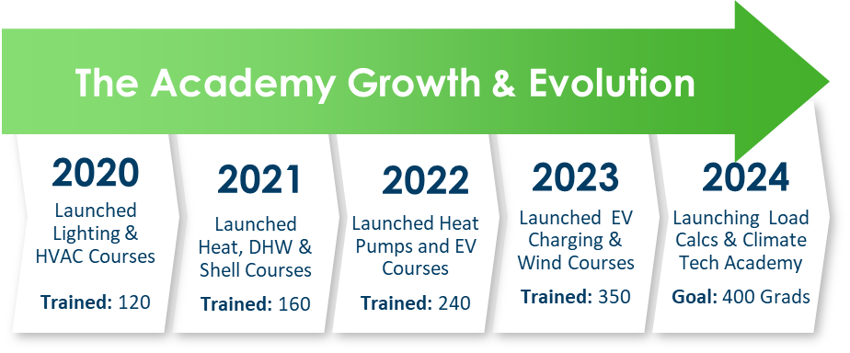
SoCalREN Commercial Program Workforce Pipeline
Willdan Clean Energy Academy - Utility efficiency program goals continue to grow, there is a need to drive growth of non-lighting measures, diversify measure mixes, and recruit, enroll, and support contractors. Goal, develop a talent pipeline and workforce development program tailored to industry needs that connects training to jobs.

Slide 15
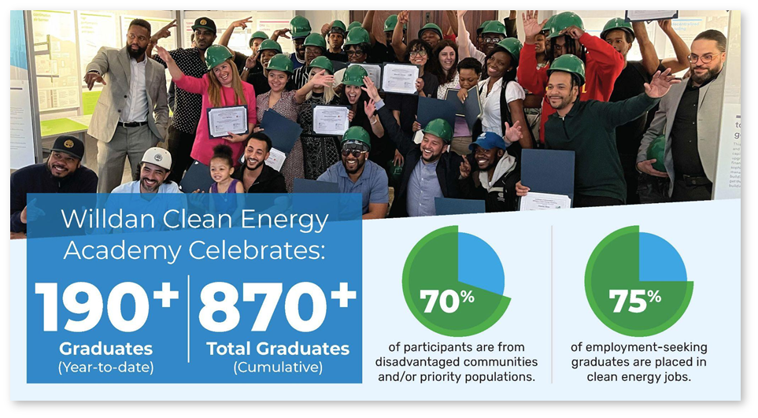
Academy Metrics & Impact
SoCalREN Commercial Programs to incorporate the Clean Energy Academy Model

Slide 16
Samuel Cervantes - ICF
Opportunities for Energy Efficiency Careers through SoCalREN’s Agricultural Program

Slide 17
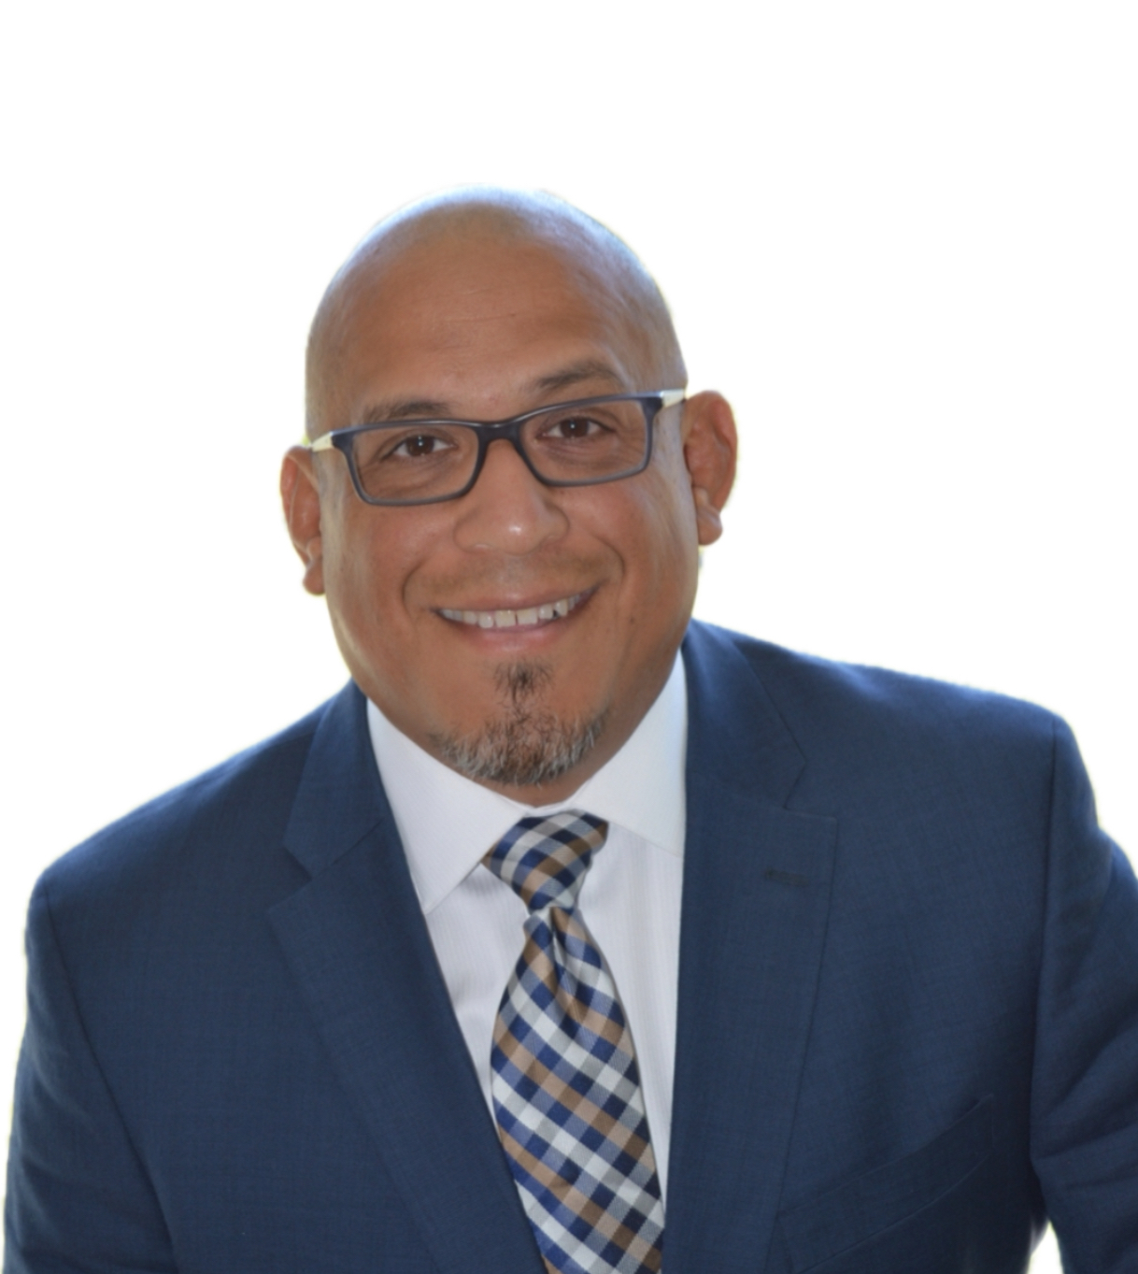
Samuel Cervantes
Account Manager - Agricultural Energy Efficiency (AgEE) Programs
Samuel Cervantes is currently the Account Manager for Agriculture Energy Efficiency (AgEE) Programs at ICF. Since joining the company, he has worked on a diverse portfolio of energy efficiency initiatives across the Residential, Commercial, Multi-Family, and most recently, Agricultural sectors, including the SoCalREN Agriculture Program. His work is centered on driving program success, building strong client relationships, supporting community outreach efforts, and delivering impactful, sustainable energy solutions.

Slide 18

SoCalREN Agricultural Program
ICF selected as the new implementer for the SoCalREN Agricultural Program
Workforce Development Connections
Creation of several new positions within SoCalREN Ag
New roles will have a strong focus on serving Hard-to-Reach (HTR), rural customers, and Disadvantaged Communities (DAC).
Opportunities for local hiring to maximize impact

Slide 19
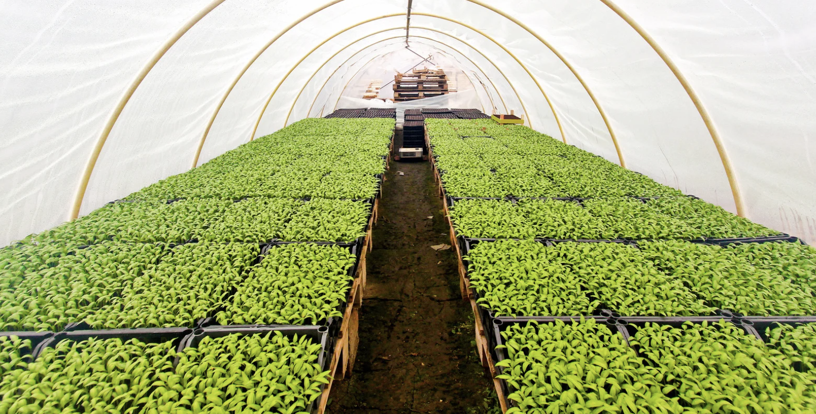
Agricultural Energy Efficiency
ICF implements several energy efficiency programs that provided incentives and rebates for upgrading to more energy efficient equipment across a variety of sectors.
Examples of current program Implementation Include:
SoCalGas Agricultural Energy Efficiency (AgEE) Program
Boilers
Heat Curtains
Hot Water Heaters
SCE Agricultural Energy Efficiency (AgEE) Program
Ventilation Fans
Horticulture LED Lighting
Variable Frequency Drives (VFD’S) for Well Pumps
Building on successes and lessons learned for SoCalREN implementation!

Slide 20
Wendy Angel, Emerald Cities Collaborative
eContractor Training Programs and Opportunities for Skilled Trades

Slide 21
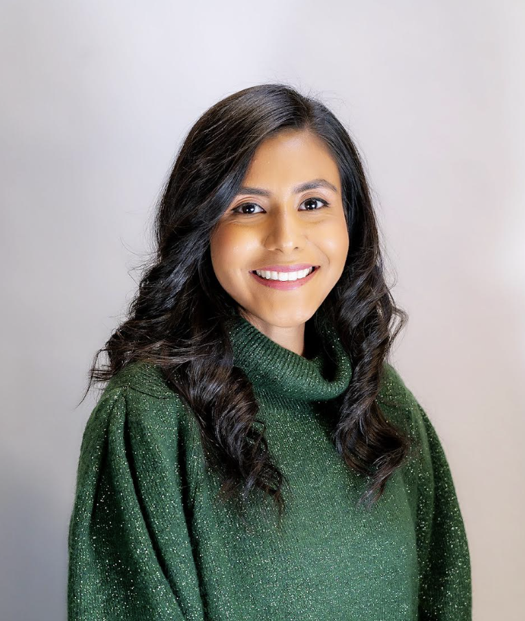
Wendy Angel
SoCal Regional Director, Emerald Cities Collaborative
Wendy Angel leads the Southern California Regional Energy Network (SoCalREN) Workforce Development Program, which facilitates access to education and training, implementing the E-Contractor Academy & Training Program to prepare small, diverse contractors to compete for energy efficiency projects within Southern California. Wendy oversees the ACES Engineering Pathway Program to expose and engage students of color to pursue STEAM careers. Wendy also manages the Green Path Careers Program, whose primary goal is to assist opportunity youth and adults work toward pursuing careers in the sustainable economy by teaching them the skills required to succeed in the energy efficiency industry.

Slide 22
SoCalREN’s E-Contractor Training Program
Building Decarb Training Academy

Slide 23
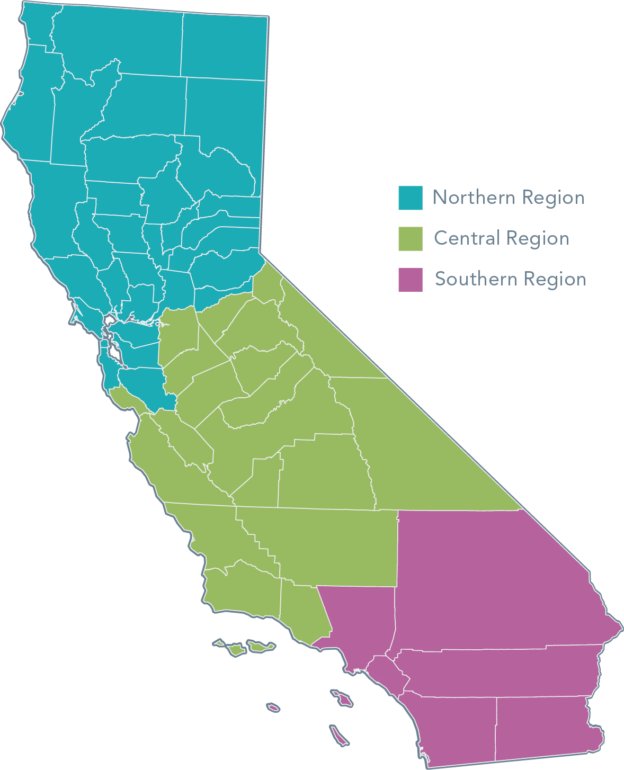
CEC EBD Program Background Information
The Equitable Building Decarbonization Program (EBD Program) will help eligible residential customers electrify their homes at no cost, reducing greenhouse gas emissions and advancing energy equity.
The EBD Program will also encourage resilience to extreme heat, indoor air-quality improvements, energy affordability, grid reliability, and local workforce opportunities.
EBD Statewide Direct Install Program
  The EBD Statewide Direct Install Program will provide building decarbonization upgrades for low-income and moderate-income households in single-family, multifamily, and manufactured homes in under-resourced communities.
  The program will be administered separately in Northern, Central, and Southern California.
Program Funding
Funded by the California Energy Commission
$783M for the Grant Program (58% for Southern California region)
Projects will be funded at a 100% grant rate; projects that leverage other funds will be more competitive
Three administrators will be competitively selected (one per region)
.
2025 County of Los Angeles Internal Services Department, Energy and Environmental Service

Slide 24



























Program Overview
EBD Statewide Direct Install Program
  The California Energy Commission's (CEC) Equitable Building Decarbonization (EBD) Direct Install (DI) program offers upgrades for low-income households.
  The County of Los Angeles leads a coalition of Community-Based Organizations, Community Choice Aggregators (CCAs), Councils of Government (COGs), and Regional Energy Networks (RENs) to deliver the program in Los Angeles, Orange, San Diego, Riverside, Imperial, and San Bernardino Counties.
2025 County of Los Angeles Internal Services Department, Energy and Environmental Service

Slide 25








Overview and Purpose
Types of No-Cost Upgrades
The SoCal EBD Program is designed to be a one-stop-shop that provides comprehensive project support services from project inception to completion: gold standard white glove project delivery for home electrification.
In addition, the SoCal EBD Program is designed to build a trade ally network of electrification experts:
  Home Electrification Concierge
  Electrification Construction Managers
  Intake Advisors
  Installation Contractors
Heating and Cooling
Water Heating
Cooking
Laundry
Lighting
Building Envelope
Electrical
Remediation and Safety

Slide 26

Building Decarbonization Pilot Academy: Heat Pump Water Heaters
Objective
The E-Contractor Building Decarb Pilot Academy is designed to prepare small and diverse contractors to perform direct install measures in order to meet California’s climate goals.
Academy Outline
Contractors will cover the following:
  Green Building Technologies
  Decarbonization Best Practices
  EPA 608 Type II Certification
  Hands on Training
    Heat Pump Installation
  Project Opportunities

Slide 27
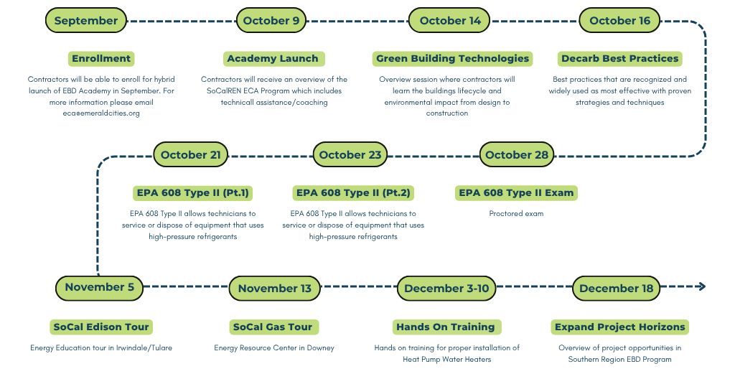
Building Decarbonization Pilot Academy Timeline (TENTATIVE)

Slide 28
Jason Crow, California Air Resources Board (CARB)
Marie Gunter
Senior Project Manager Electrification Education - TRC Companies
Clean Energy Jobs Critical to Improved Air Quality in the Central Valley

Slide 29
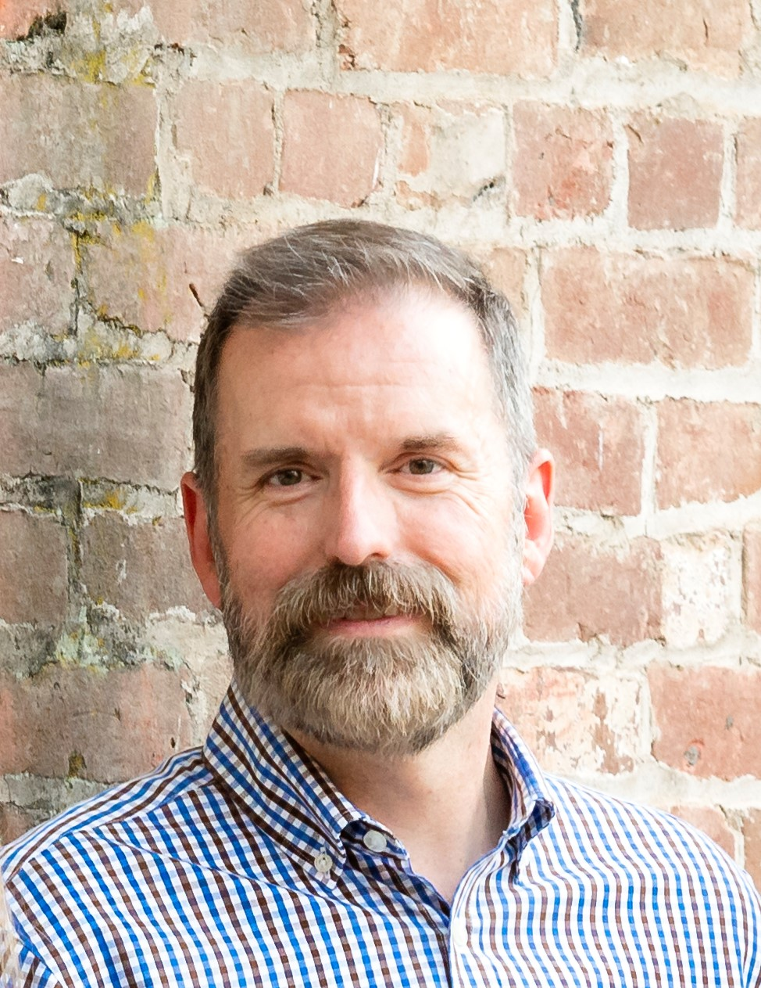
Jason Crow
Manager, California Air Resources Board (CARB)
Jason Crow is a manager in the California Air Resources Board’s Mobile Source Control Division where he oversees implementation of California’s Volkswagen Environmental Mitigation Trust program, the development of the annual Long-Term Heavy-Duty Investment Strategy, and implementation of CARB’s workforce training and development projects. Jason has fifteen years of experience with CARB, and a total of 30 years of experience at various public agencies working in transportation planning, transit and parking operations, transportation funding, freight planning, and air quality planning.

Slide 30
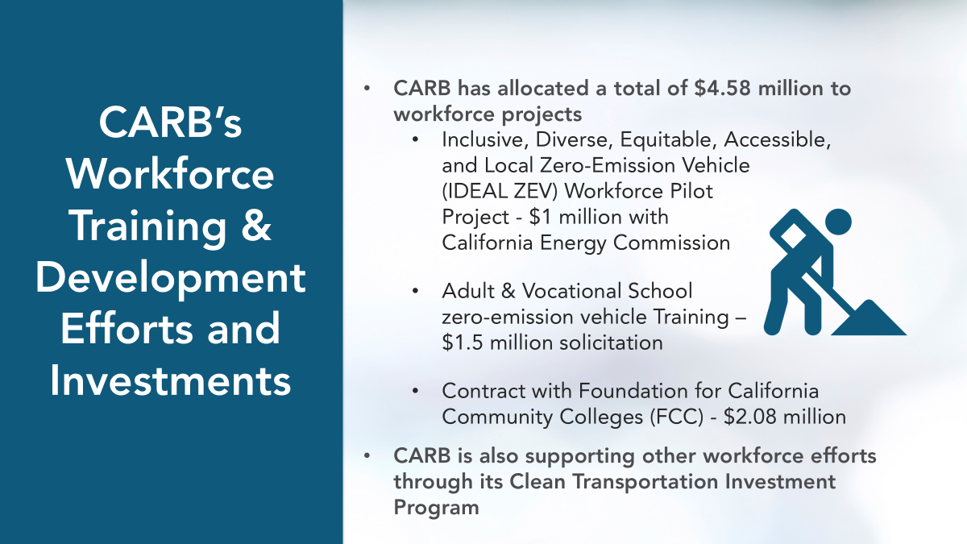

Slide 31
Questions for Panelists:
Rosie Kang, Regional Partner Liaison, Willdan
Samuel Cervantes - Account Manager - Agricultural Energy Efficiency (AgEE) Programs, ICFF
​Wendy Angel - SoCal Regional Director, Emerald Cities Collaborative
Jason Crow - Manager of Heavy Duty Energy Efficiency Rebate Programs, California Air Resources Board (CARB)

Slide 32
Southern California Edison (SCE)
Mobile Education Unit Program
Marie Gunter
Senior Project Manager Electrification Education - TRC Companies
Hosting Site Program Spotlight: SCE’s Mobile Education Unit

Slide 33
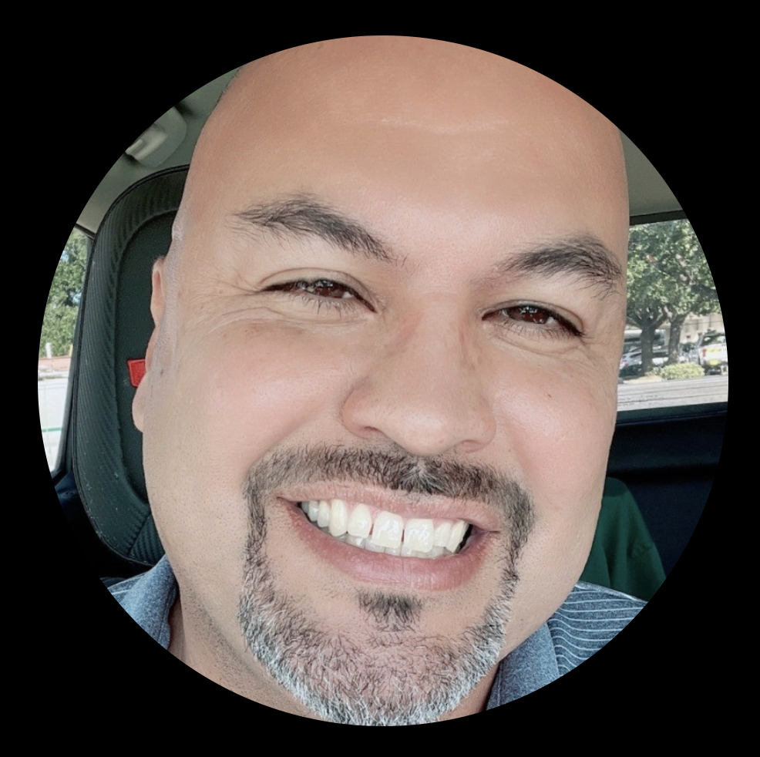
Lionel Moreno
IEET Mobile Education Unit
Lionel has dedicated nearly 20 years to Southern California Edison’s Customer Service Division, driven by a passion for helping customers and empowering the future workforce. Currently, I lead the Mobile Education Unit Program, where we engage communities to promote energy savings, financial empowerment, career awareness, and environmental responsibility.

Slide 34
SCE Energy Education Centers Overview
June 4, 2025

Slide 35
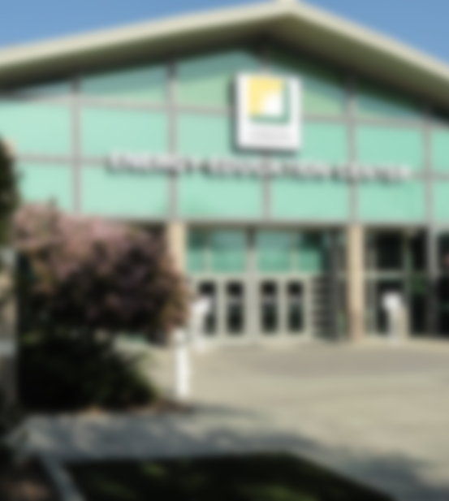
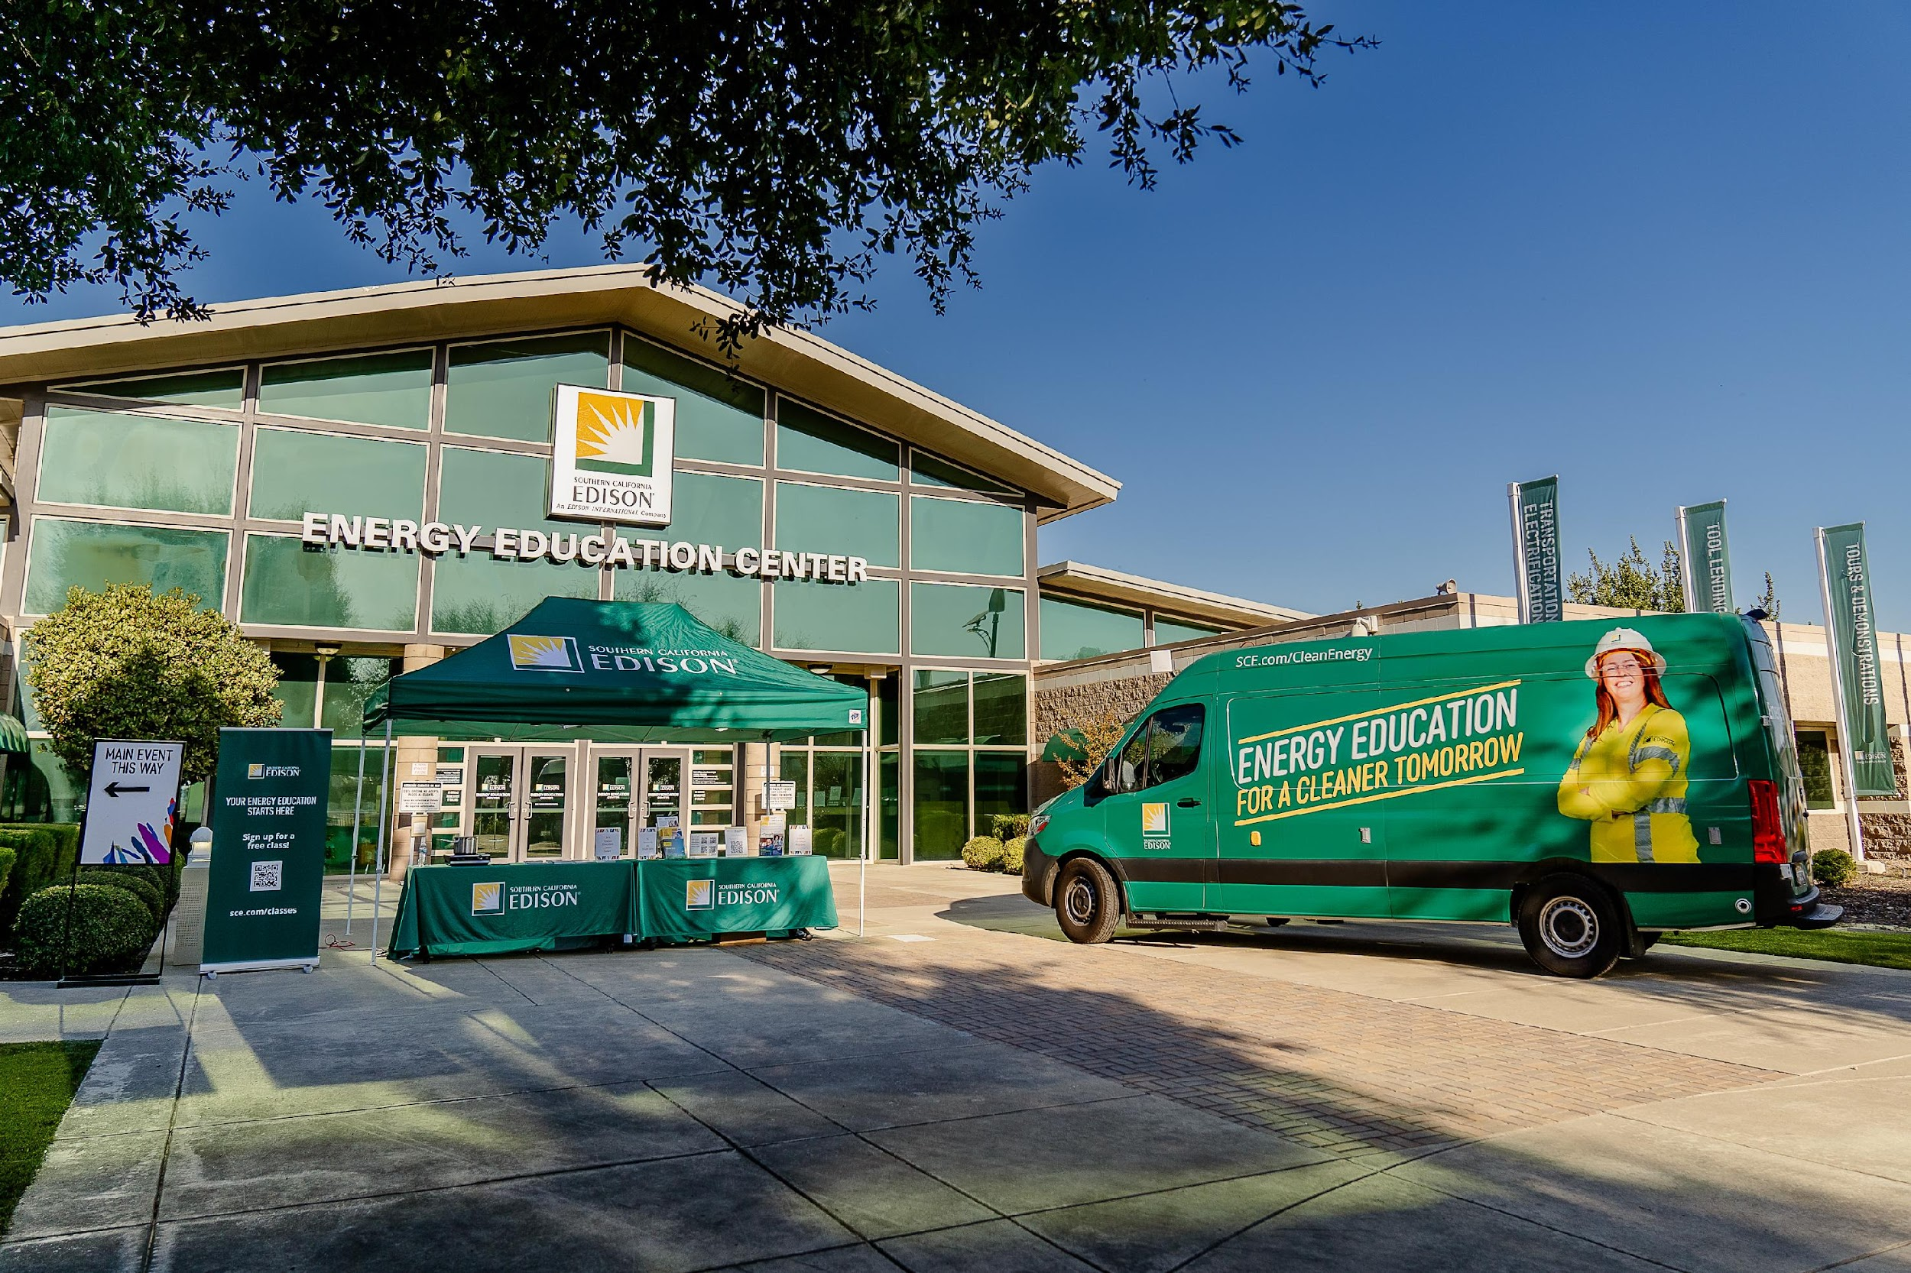
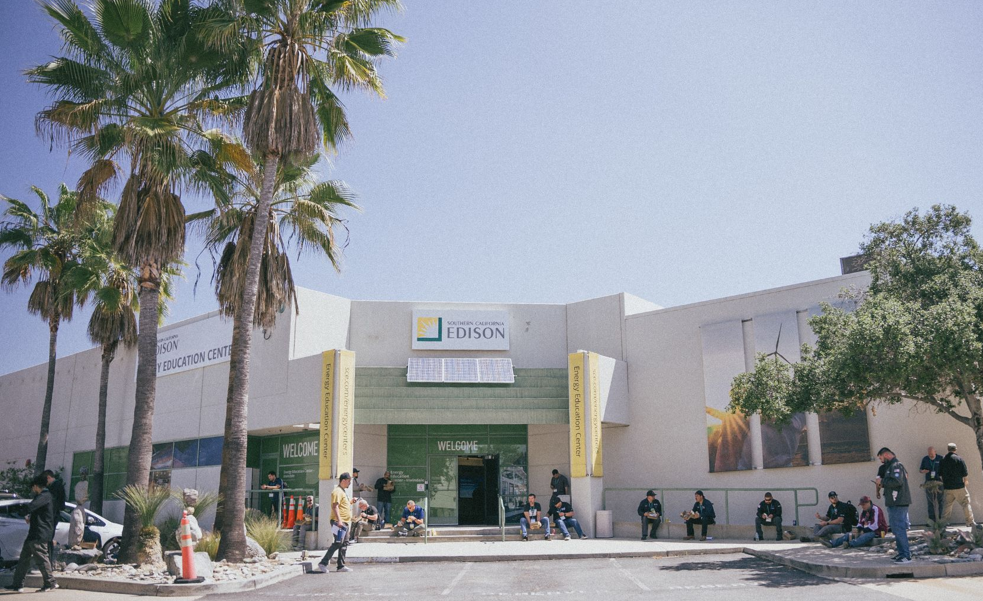
Energy Education Centers
Locations in Irwindale (51,000 sq. ft.) and Tulare (30,000 sq. ft.)
Deliver technical workforce training through CPUC Workforce Education & Training (WE&T) program funding to preparing California’s workforce to support the needs of a clean energy future
Facilities feature state-of-the-art testing, demonstration centers, labs, and classrooms showcasing the latest energy technologies
Also provide event hosting and logistics support, connecting SCE with key stakeholders
Tulare
Irwindale

Slide 36
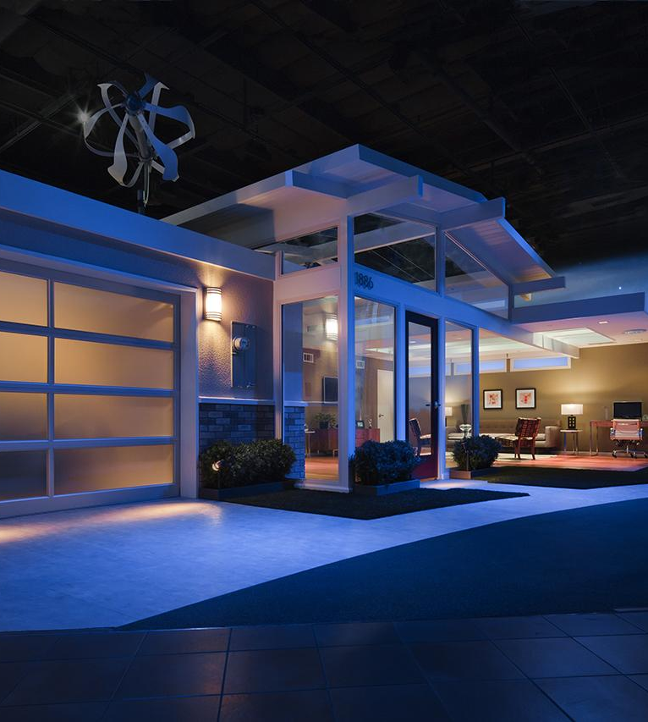
Integrated Energy Education & Training (IEET) Program
Technical Training: Delivers technical upskill training through the Energy Education Centers (EEC) by way of live, virtual, and on-demand seminars in 11 technology areas, and Collaborations with Community Based Organizations and educational institutions to expand reach
Foodservice Technology Center (FTC): Offers cutting-edge demonstrations, training, and consultations on energy-efficient foodservice technologies, driving sustainability in the commercial kitchen industry
Mobile Education Unit (MEU): Brings energy education directly to communities, focusing on underserved and hard-to-reach areas, through a mobile classroom equipped with interactive displays and demonstrations, promoting clean energy technologies and workforce development opportunities
Lending Programs: The Tool Lending Library (TLL) and Induction Lending Program (ILP) provide essential resources to support energy efficiency projects and promote the adoption of electric cooking technologies

Slide 37
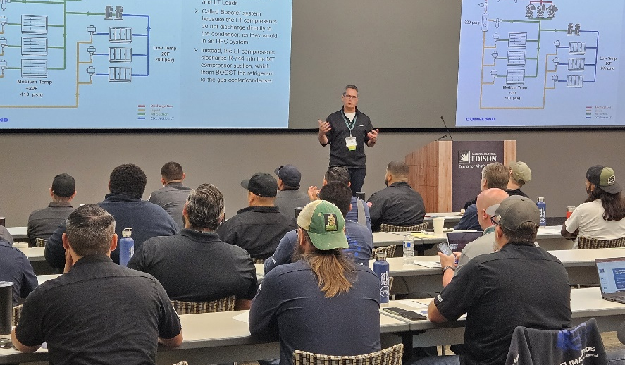
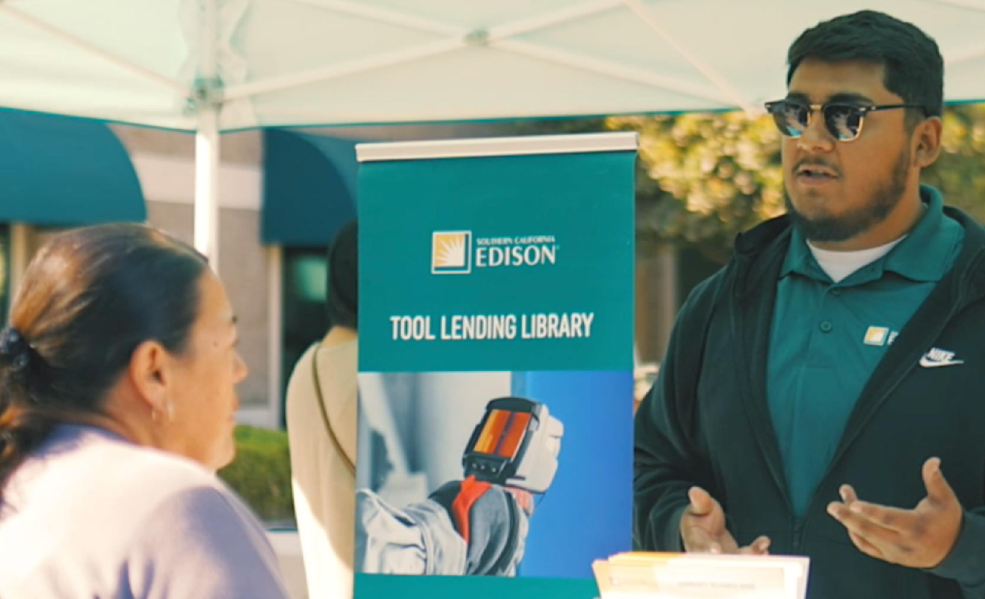
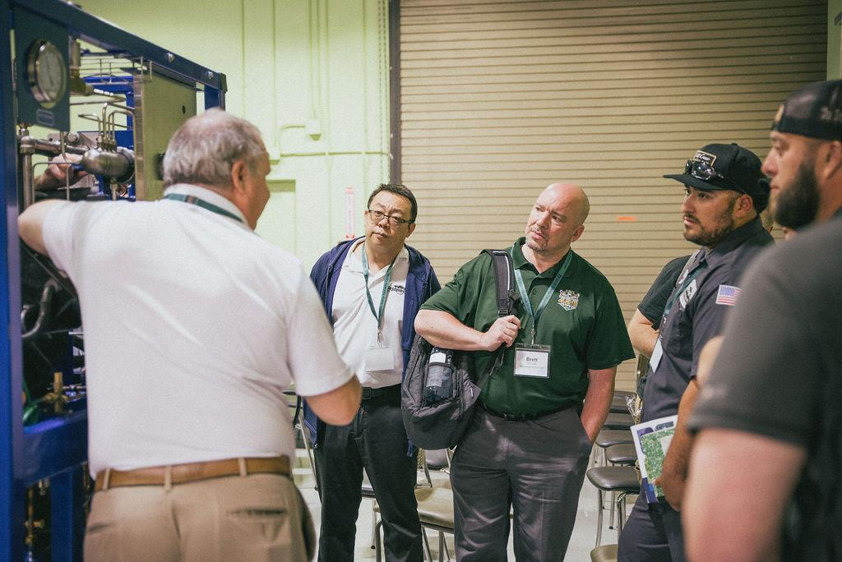
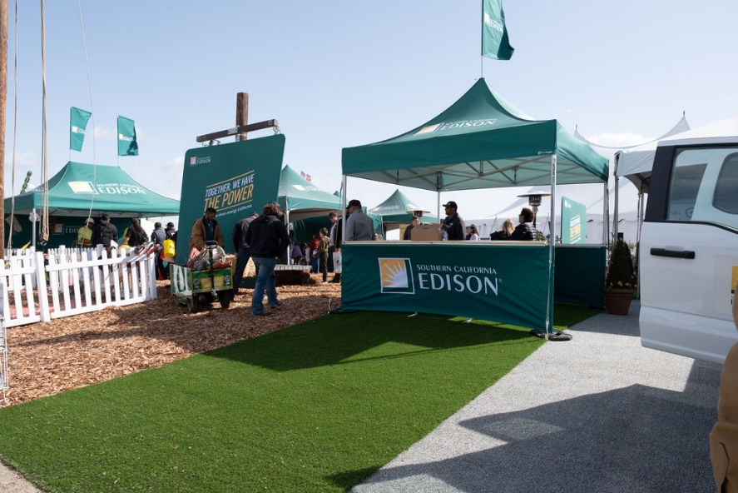
29,482
attendees
73% of attendees
Workshop Attendance
Disadvantaged Worker Reach
The Energy Education Centers reached a record number of attendees in 2024 with our online and in-person workshops
We ensure that minority, low income and disadvantaged communities fully participate in training and education programs at all levels
607
courses
14,084
visitors
Workshop Offerings
Mobile Education Unit Outreach
Live in-person and online plus OnDemand courses on dozens of topics to help trade workers, homeowners and energy enthusiasts with their energy needs
Participated in 184 outreach events with bringing interactive educational experiences to local communities

Slide 38
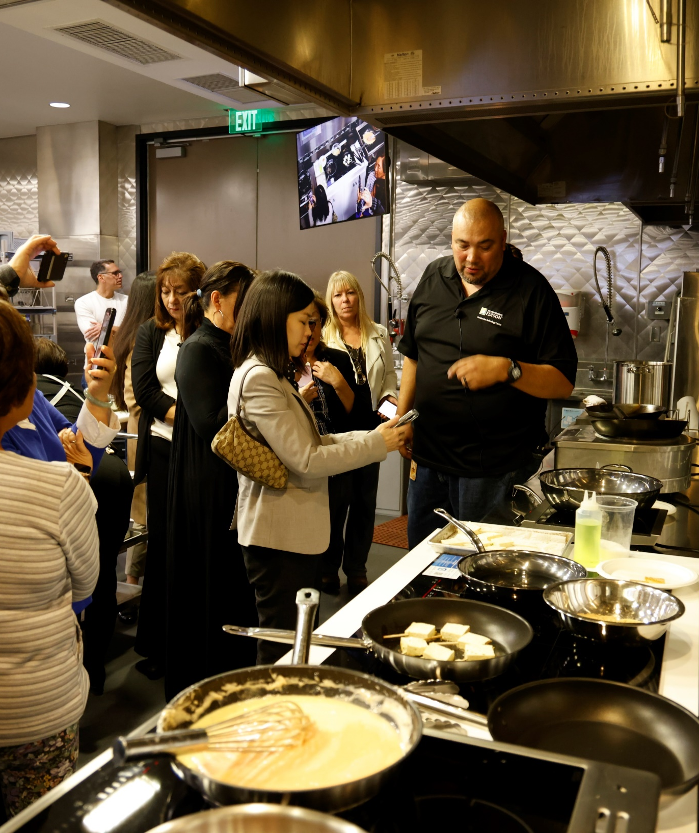
Foodservice Technology Center (FTC)
An industry-renowned, one-of-a-kind demonstration kitchen and functioning laboratory that showcases the latest energy-efficient electric commercial foodservice technologies.
Provides hands-on experiences, technical support, and educational opportunities to drive the adoption of sustainable practices and electric cooking technologies in the food service industry supporting SCE's clean energy goals.
Equipment Performance Testing: Test residential (120/240 Volt) and commercial (480 Volt) appliances to support the development of new energy efficiency standards and customer incentive measures for various food service segments
Collaborations and Technical Support: Engage industry associations, educational institutions, government agencies, and community-based organizations to drive research, development, and market transformation
Training and Education: Diverse range of seminars, workshops, and demonstrations combining classroom learning with hands-on experiences

Slide 39

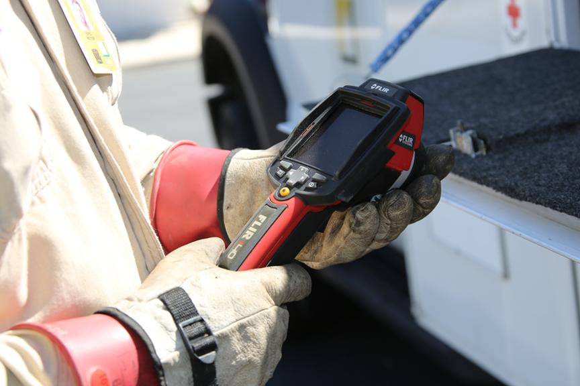
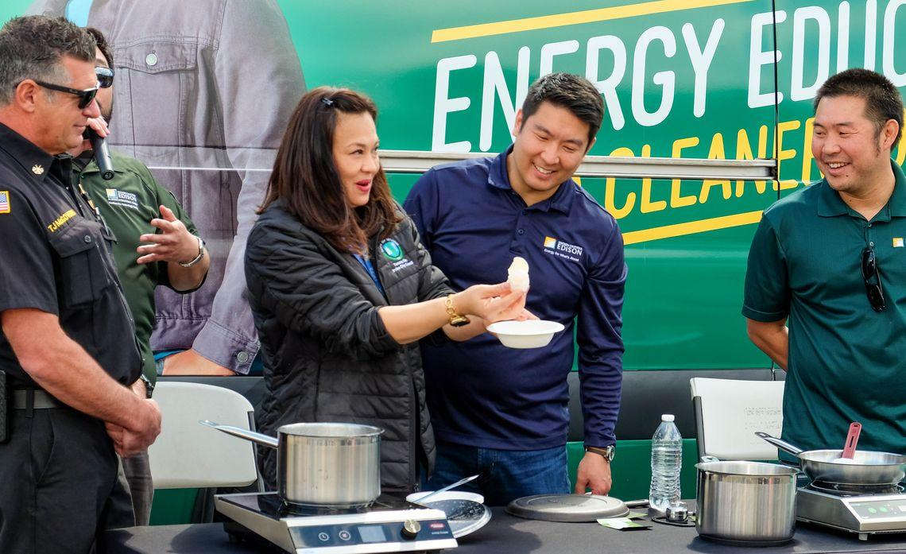
Lending Programs
The Energy Education Centers' lending programs, including the Tool Lending Library (TLL) and Induction Lending Program (ILP), provide essential resources to support energy efficiency projects and promote the adoption of electric cooking technologies. By offering free loans of specialized tools and equipment, these programs enable hands-on learning, drive market transformation, and contribute to SCE's clean energy goals.
Tool Lending Library (TLL): Offers a wide range of building performance and energy measurement tools that can be borrowed free of charge, with a dedicated display room at the Irwindale Energy Education Center showcasing the available tools and their applications
Induction Lending Program (ILP): Provides free loans of high-quality, commercial-grade induction cooktops and cookware to both residential and commercial customers supporting SCE's building electrification efforts in the food service industry

Slide 40

Energy Education Collaborations
At the Energy Education Center, our goal is to make energy education accessible to everyone. We’re achieving this by teaming up with a variety of partners—from community organizations to educational institutions
Highlights
Architecture at Zero Design Competition
  What We Did: Partnered with architects and students to create innovative, energy-efficient building designs
  Why It Matters: This project highlighted the importance of sustainability and equity in design, influencing how communities think about and implement energy solutions
Energize Colleges Program
  What We Did: Worked with colleges to incorporate energy topics into their curricula and provide real-world training experiences
  Why It Matters: We’re helping shape future energy leaders by engaging students early in their careers

Slide 41
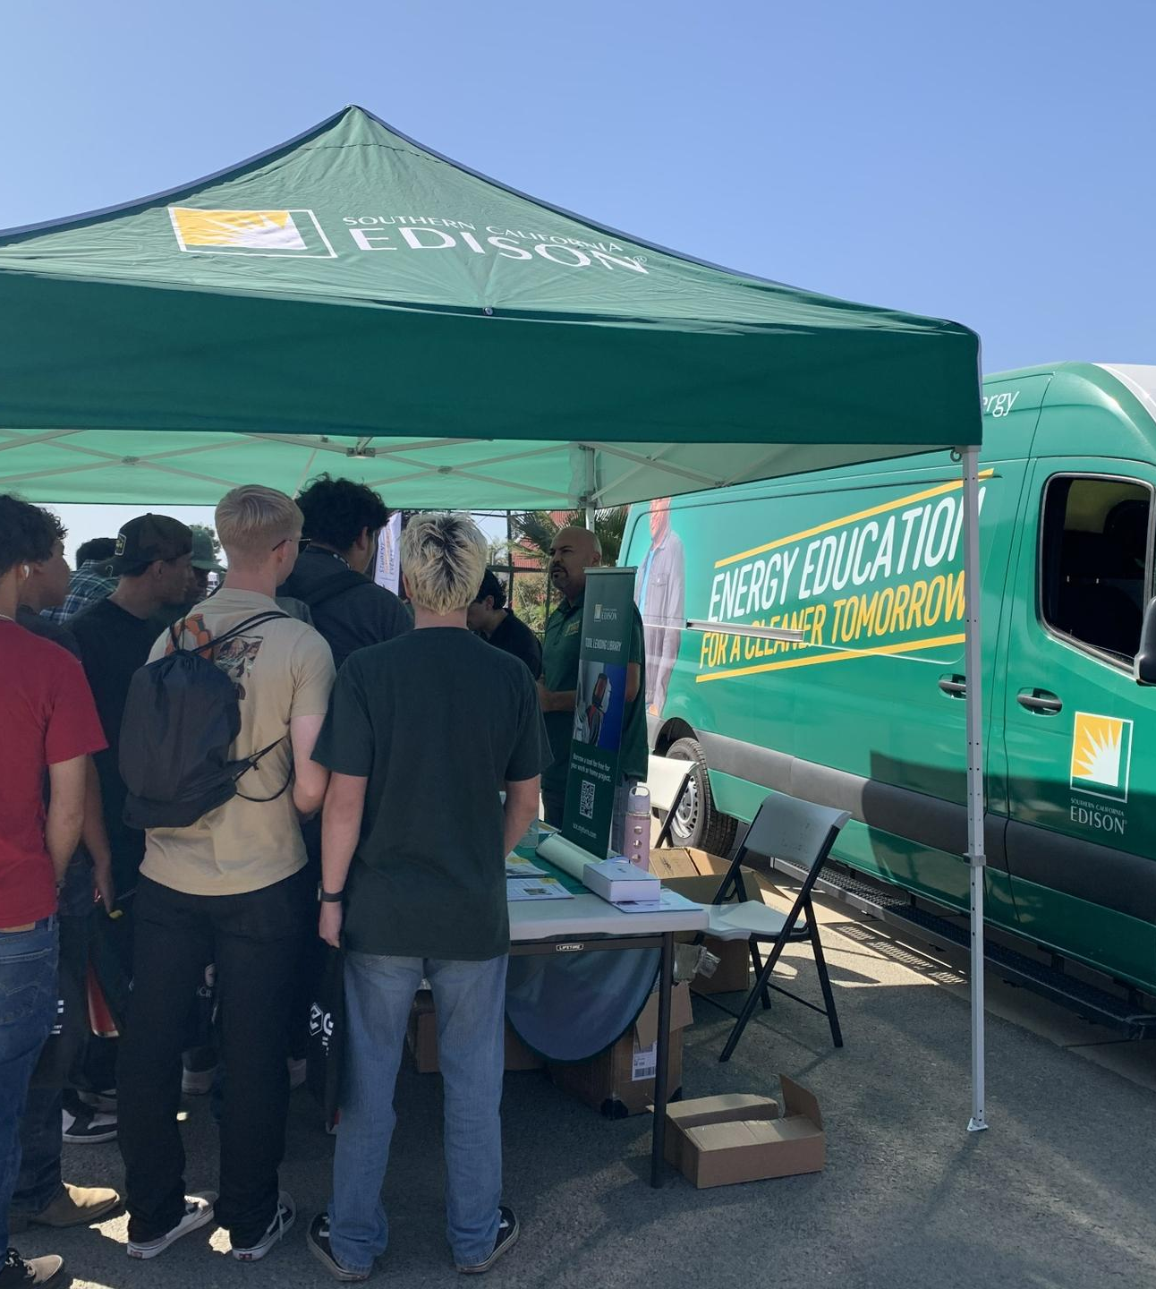
Mobile Education Unit (MEU)
The Mobile Education Unit (MEU) provides an innovative platform to educate and engage communities on building electrification and energy efficiency. The goal is to bring interactive learning experiences tailored to local needs, especially to disadvantaged communities (DACs). This initiative aimed to reduce barriers for underserved communities by bringing hands-on demonstrations and educational opportunities directly to areas that may have faced challenges in accessing traditional educational channels.
Outreach to Disadvantaged Worker Community: Attend events, engage customers, and deliver electrification courses to foster greater understanding and adoption in DACs.
Promote Sustainable Practices in Hard-to-Reach Areas: Create a dynamic learning environment empowering individuals and communities to embrace sustainable energy solutions, supporting SCE's clean energy goals.
Kicking off an exciting educational outreach initiative, the MEU program, in partnership with Horizon Marketing, is connecting with community colleges, high schools, and other CTE programs. This initiative aims to inspire students by introducing them to exciting clean energy job opportunities.

Slide 42
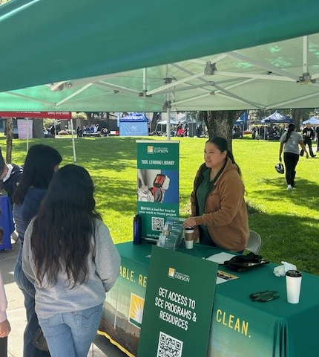
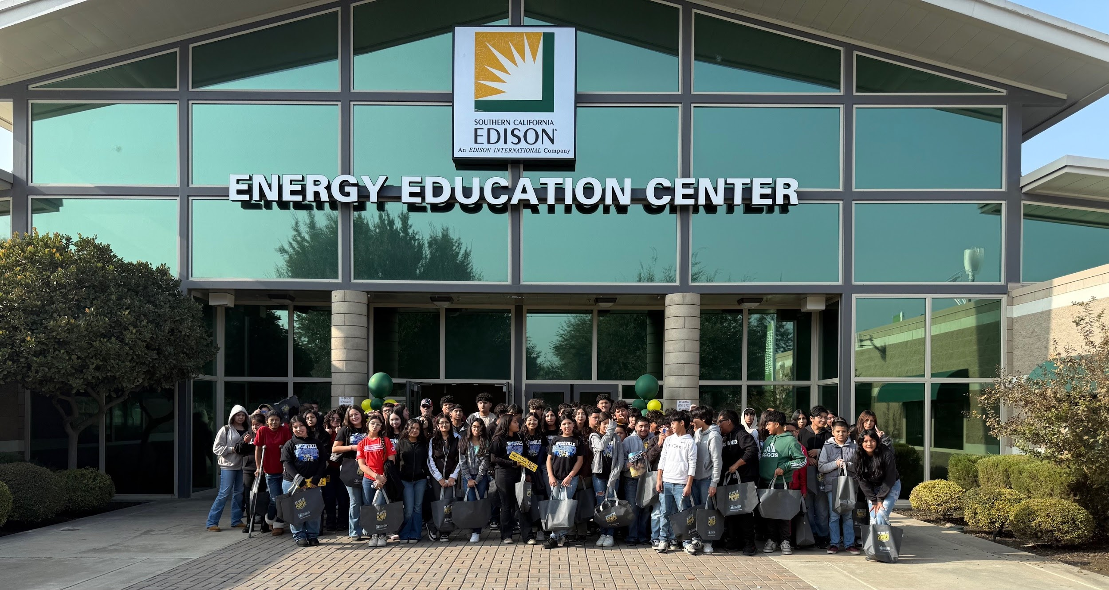
MEU Outreach in the Central Valley
Presentations at San Joaquin Valley College Electrician and HVAC students
Events in local high school programs such as Porterville AERO Academy, Delano High School Career Day, Tulare County Office of Education's Trades Day
Connections with College of Sequoias, Reedley College, and Lemoore College
Large community events such as World Ag Expo and the Tulare County Fair

Slide 43
Break Out + Activate!
Name, organization, Connection to SoCalREN
What Clean Energy, Energy Efficiency, Project Development or related jobs need to be filled in your region?
What certifications/education/skills are required for these jobs? Today and in the future (3-5 years)?
How can we increase equitable access to these training and job pathways? Do you have good examples to share?
What existing resources, programs, or incentives do you want to share with the group? Where do you see gaps?
Notes:
https://miro.com/app/board/uXjVIs0M3Yk=/

Slide 44
Closing Remarks - Lujuana Medina, SoCalREN

Slide 45
Thank You!

