Slide 1
SoCalREN Q1 2026 Regional Workforce Alliance Meeting
March 18, 2026
Lyle Center for Regenerative Studies
Cal Poly Pomona

Slide 2
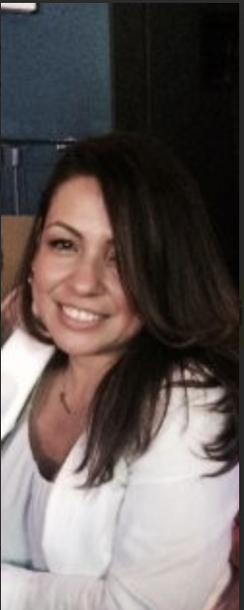

Lujuana Medina
Environmental Initiatives Division Manager - SoCalREN, County of Los Angeles
Lujuana is responsible for managing and operating environmental initiatives programs administered by the County of Los Angeles. This includes the Southern California Regional Energy Network (a portfolio of energy efficiency programs) and the SoCal EVen Access (a portfolio of EV infrastructure programs). Additionally, she leads policy and grant development regarding energy efficiency, distributed energy resources, clean energy programs, and the electrification of transportation. Over the past 15 years, she has worked in a variety of capacities within the energy industry. Before joining the County of Los Angeles, Lujuana served as the Energy Policy & Regulatory Manager as a consultant for various clients, as the Energy Efficiency Policy Lead Advisor for Southern California Gas Company, as a Regulatory Case Manager in the Power Procurement Department for Southern California Edison, as a Generation Resource Planner and Utility Finance Advisor for San Diego Gas & Electric.

Slide 3
Agenda
11:30 AM - 12:00 PM - Networking Lunch & Opening Speakers, The Commons at The Lyle Center
11:45 AM Welcome - Lujuana Medina, Environmental Initiatives Division Manager, County of Los Angeles, Internal Services Department
11:50 AM Moderator’s Welcome - Tessa Charnofsky, Special Services Assistant, SoCalREN
11:55 AM Keynote - Alycia Gilde, Chief Strategy Officer for Climate Action Partnerships, ISD, LA County
12:10 PM - 1:40 PM - Panel Discussion and Q&A
Featured Panel Discussion: Powering High Road Jobs Through Clean Infrastructure
Expert Panelists:
Tori Shepherd, Director of Enterprise Sustainability, Prologis
Nenetzin Rodriguez, Project Manager, The Energy Coalition / Pomona Acts
Falisha Lucas, Deputy Director, Tribal Affairs, CALSTART
Eddy Santosa, Sustainability and Resilience Practice Lead, North America: West, Parsons
1:40 PM - 1:50 PM - ​Program Spotlight - Program Spotlight: Dr Mary Anne Akers, Dean of the College of Environmental Design, Cal Poly Pomona
1:50 PM - 2:00 PM - Closing Remarks - Ben Stapleton, CEO, USGBC-CA on behalf of SoCalREN
2:00 PM - 2:30 PM- Optional Tour: Lyle Center for Regenerative Studies

Slide 4
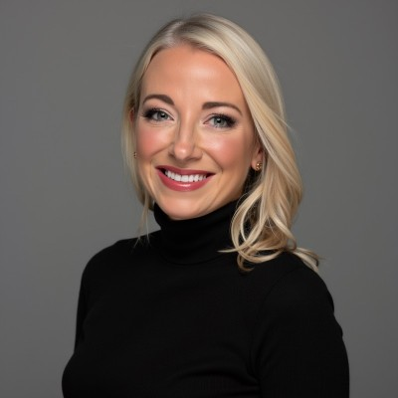
Alycia Gilde
Global Changemaker & Infrastructure Strategist
Alycia Gilde is a "Disruptor for Good" with over 23 years of experience architecting the nation’s most ambitious emission reduction programs. Currently serving as the Chief Strategy Officer for Climate Action Partnerships at the LA County Internal Services Department, she spearheads the decarbonization of municipal infrastructure for 10 million residents. A specialist in California’s energy and transportation nexus, Alycia is currently leveraging an ecosystem approach to accelerate Zero-Emission Vehicle (ZEV) deployment and grid resiliency, positioning Los Angeles as a global innovation hub ahead of the World Cup and LA28.
Before her leadership in LA County, Alycia secured nearly $1B in clean vehicle and infrastructure incentives and pioneered the national framework for zero-emission corridor planning. Her expertise lies in transforming fragmented logistics hubs into resilient energy ecosystems, strategically deploying technology to decarbonize global freight and supply chains. With a career spanning the White House, U.S. Department of Energy, and the United Nations, she remains a premier voice in bridging the gap between public policy and private industry to fuel an equitable, sustainable future.

Slide 5
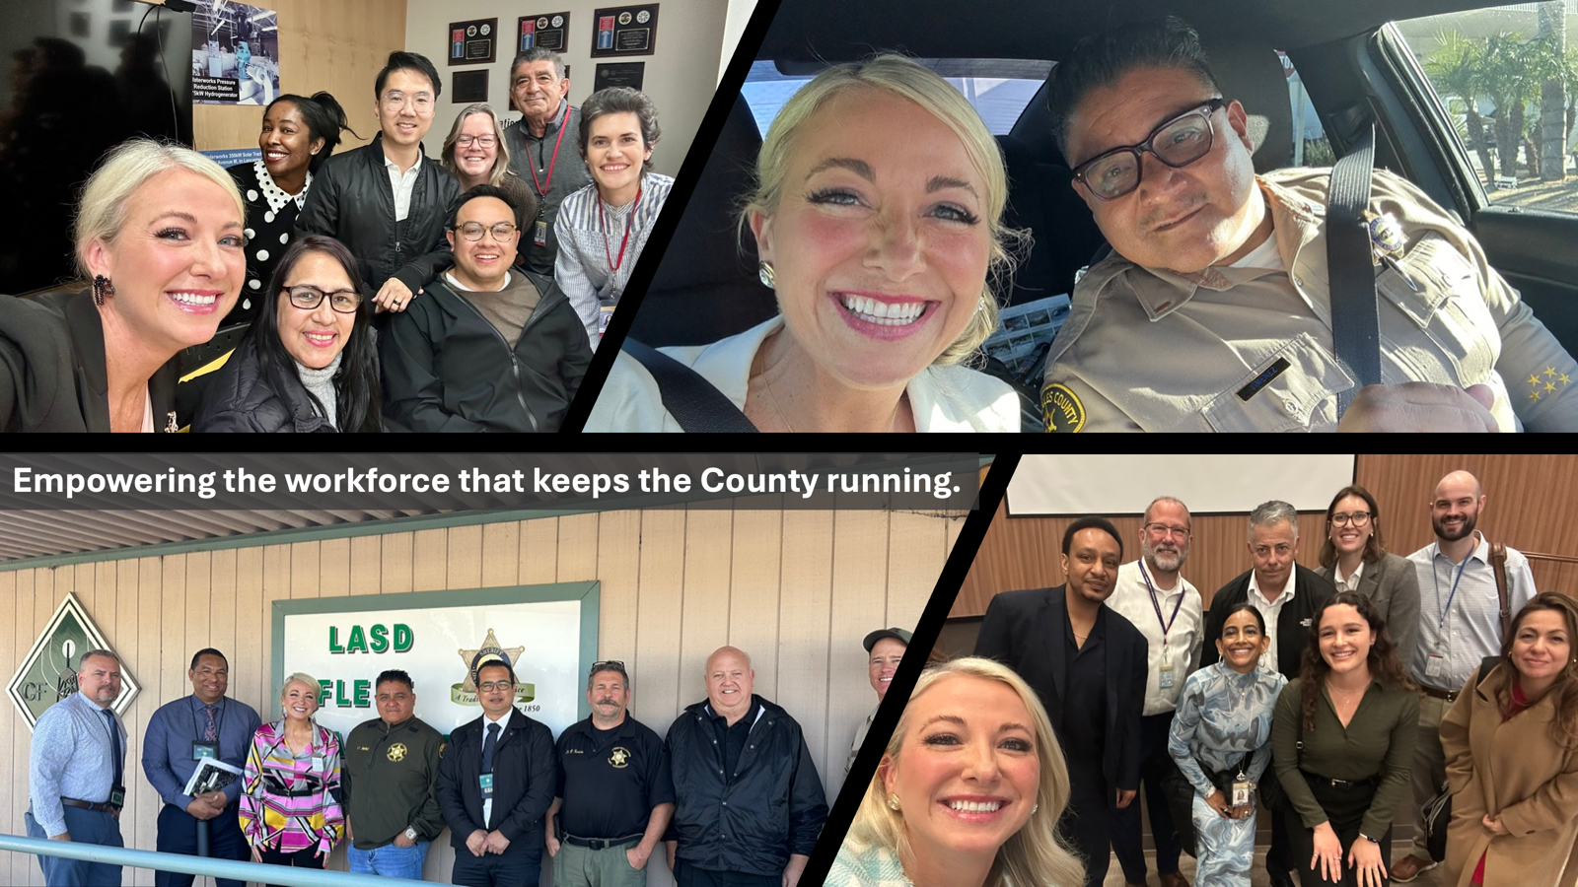

Slide 6
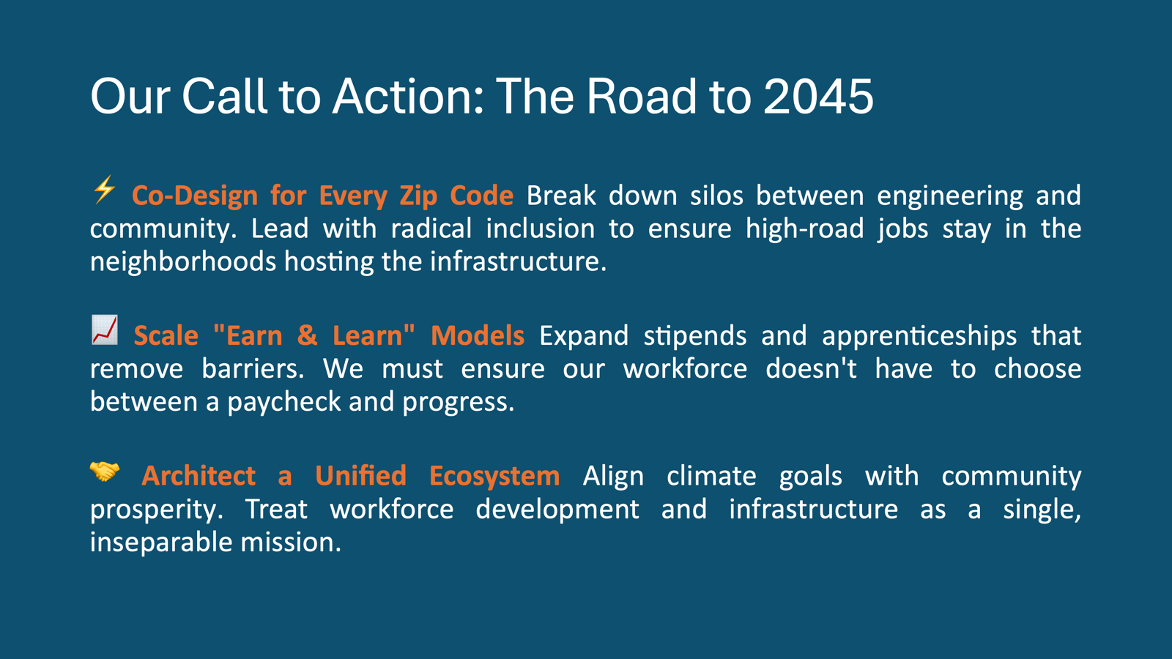

Slide 7
Powering High Road Jobs Through Clean Infrastructure

Slide 8
Meet the Experts!
Moderator - Tessa Charnofsky, Program Manager, SoCalREN
Panelists:
Tori Shepherd, Director of Enterprise Sustainability, Prologis
Nenetzin Rodriguez, Project Manager, The Energy Coalition/Pomona Acts
Falisha Lucas, Deputy Director, Tribal Affairs, CALSTART
Eddy Santosa, Sustainability and Resilience Practice Lead, North America: West, Parsons

Slide 9
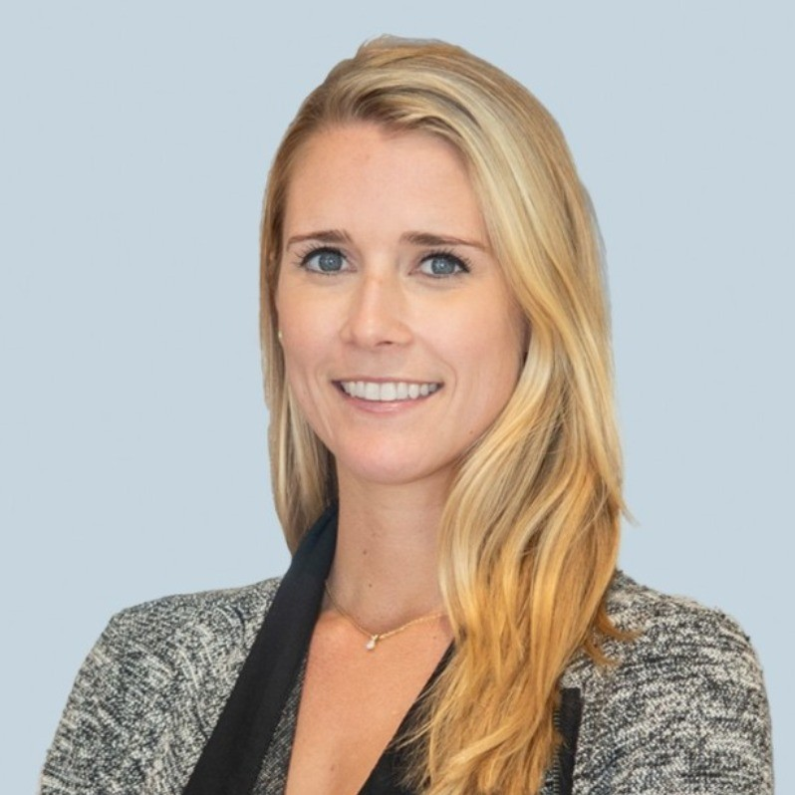
Tori Shepard
Director of Enterprise Sustainability
Tori Shepard is the Enterprise Sustainability Director for the Americas at Prologis, where she manages key customer relationships and drives integrated solutions in Energy, Mobility, and Sustainability (EMS). She specializes in delivering high-impact decarbonization infrastructure, including solar, battery storage, EV charging, and on-premise power.
With a deep track record in the real estate industry, Tori previously led CBRE Property Management Sustainability Services for the US West, spearheading data, compliance, and carbon reduction initiatives. Her global expertise includes six years at the International WELL Building Institute (IWBI), where she guided some of the world’s first WELL Portfolios to align health and wellness with ESG strategy.
A recognized industry leader, Tori was honored as both the 2022 CoreNet Australia and CoreNet Global Young Leader of the Year. She holds a BA in Environmental Studies from Yale University, where she was a sustainability ambassador and captain of the varsity volleyball team.
Tori’s technical rigor is backed by elite industry credentials, including WELL Faculty, LEED Green Associate, and Carbon Auditing Professional (AEE). Driven by her CliftonStrengths—including Achiever and Futuristic—she is dedicated to defining the next era of sustainable logistics.

Slide 10
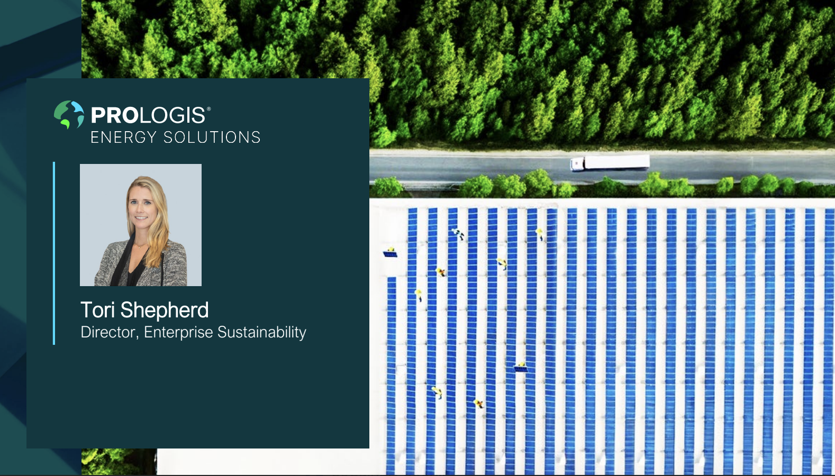

Slide 11
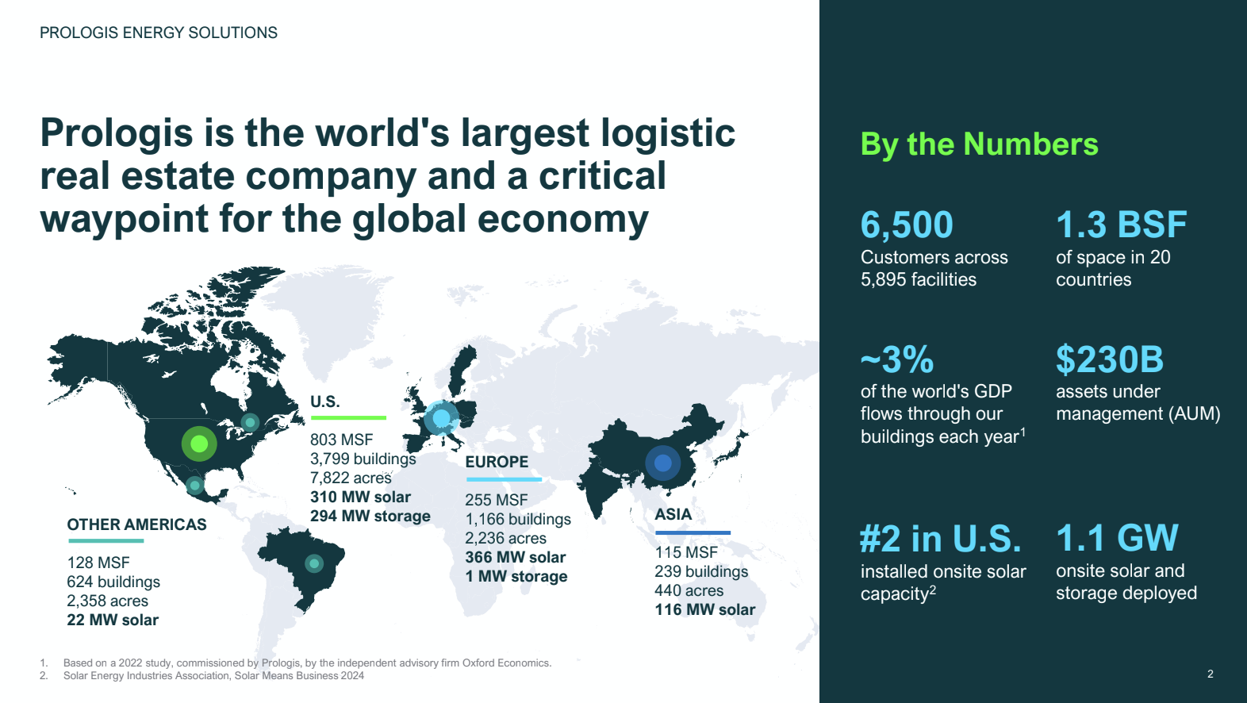

Slide 12
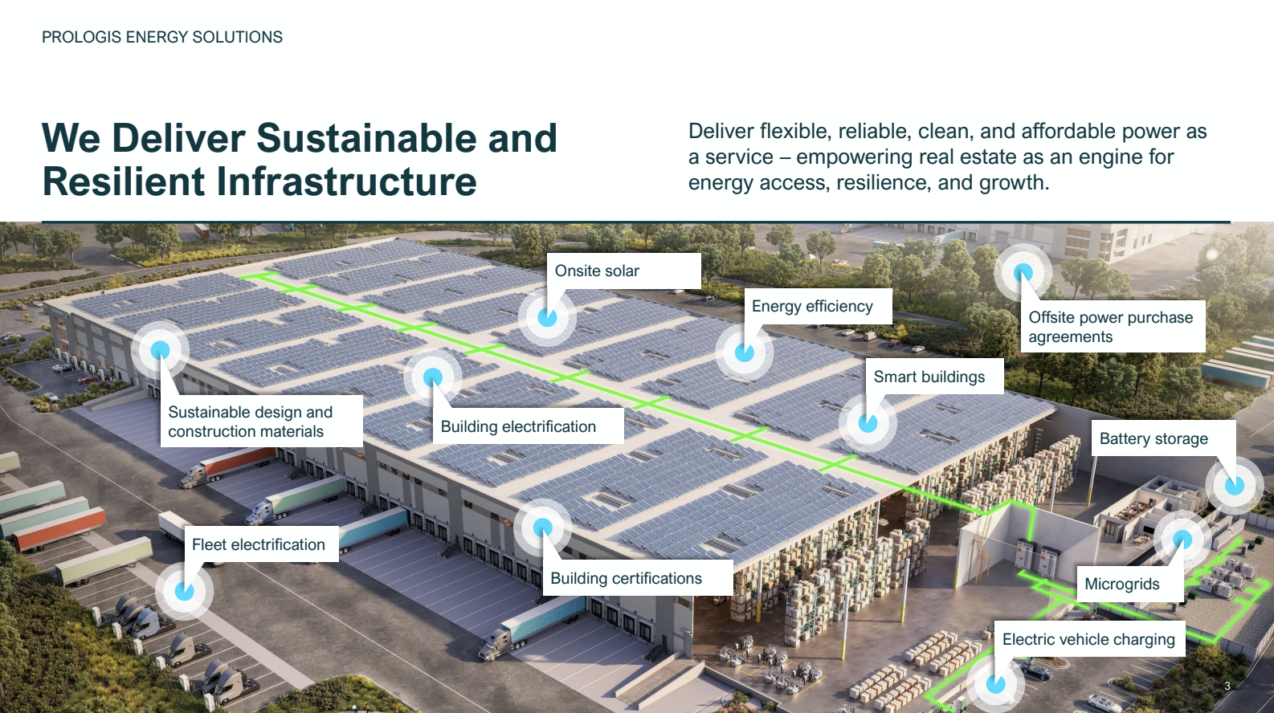

Slide 13
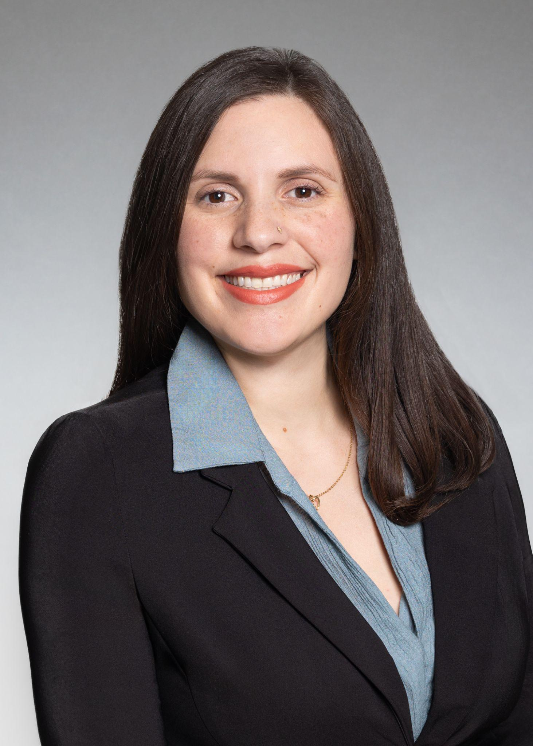
Nenetzin Rodriguez, MPA
Project Manager, The Energy Coalition
Nenetzin Rodriguez is Project Manager for the Pomona ACTS Project at The Energy Coalition, where she leads community based initiatives focused on clean energy, environmental justice, and public health. She brings more than 12 years of experience in civic engagement across energy efficiency, active transportation, public policy, and K-12 STEM education.
Her work has included helping launch the first Safe Routes to School Program for Pasadena Unified School District, leading pedestrian and bicycle safety campaigns for the City of Pasadena, and advancing environmental policy and programming that expand outdoor education and access to green spaces in the San Gabriel Valley. Most recently, she led outreach efforts for electrification upgrades across 53 homes in Bassett Avocado Heights and surrounding communities, supporting the installation of solar, battery storage, heat pump water heaters, and induction stoves.
Nenetzin holds a Bachelor of Science in Anthropology from the University of California, Riverside, and a Master of Public Administration from California State University, Los Angeles. She also served two years as an AmeriCorps member and was a Congressional Fellow for Congressman Jimmy Gomez in California’s 34th District.

Slide 14




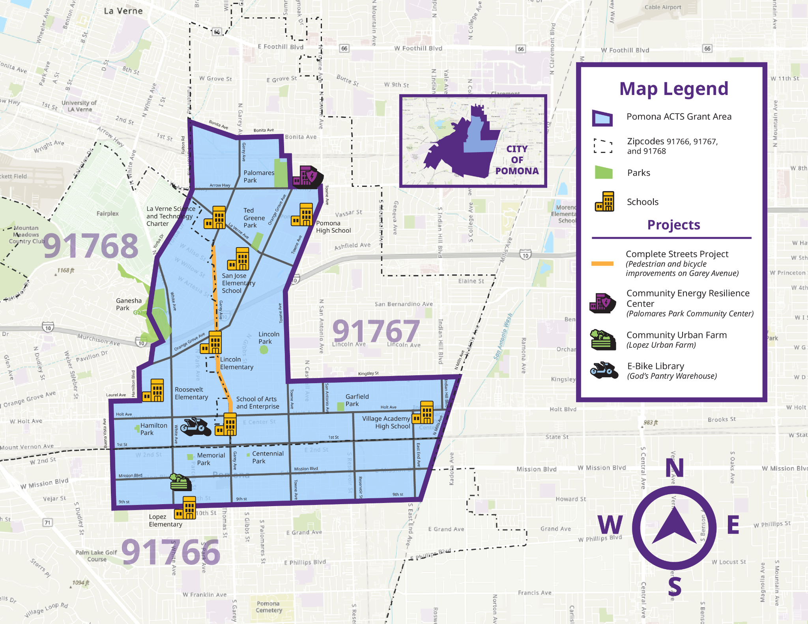
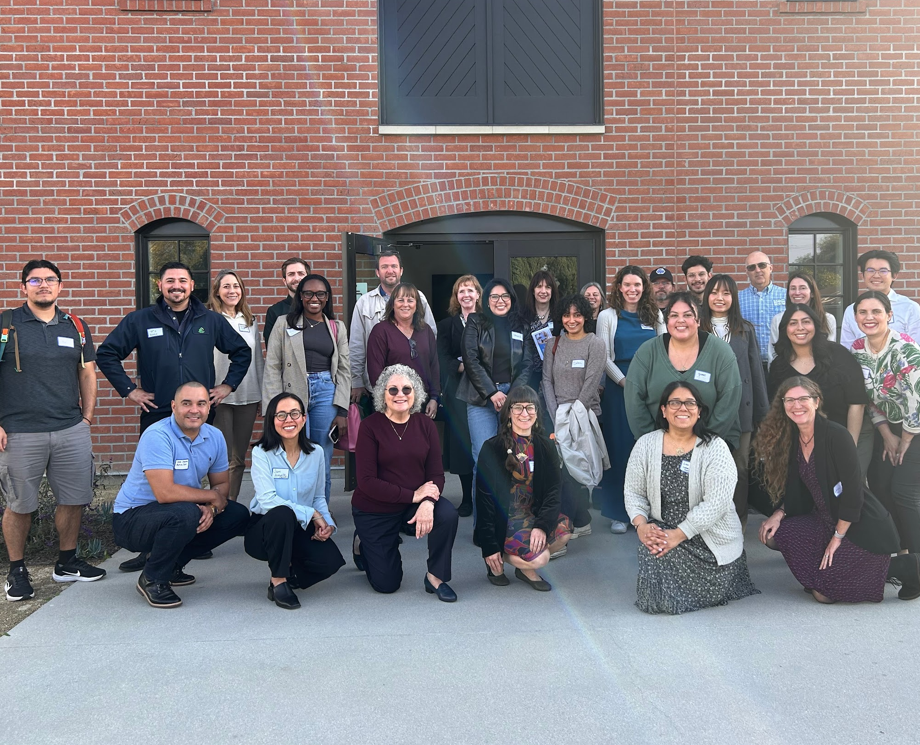


















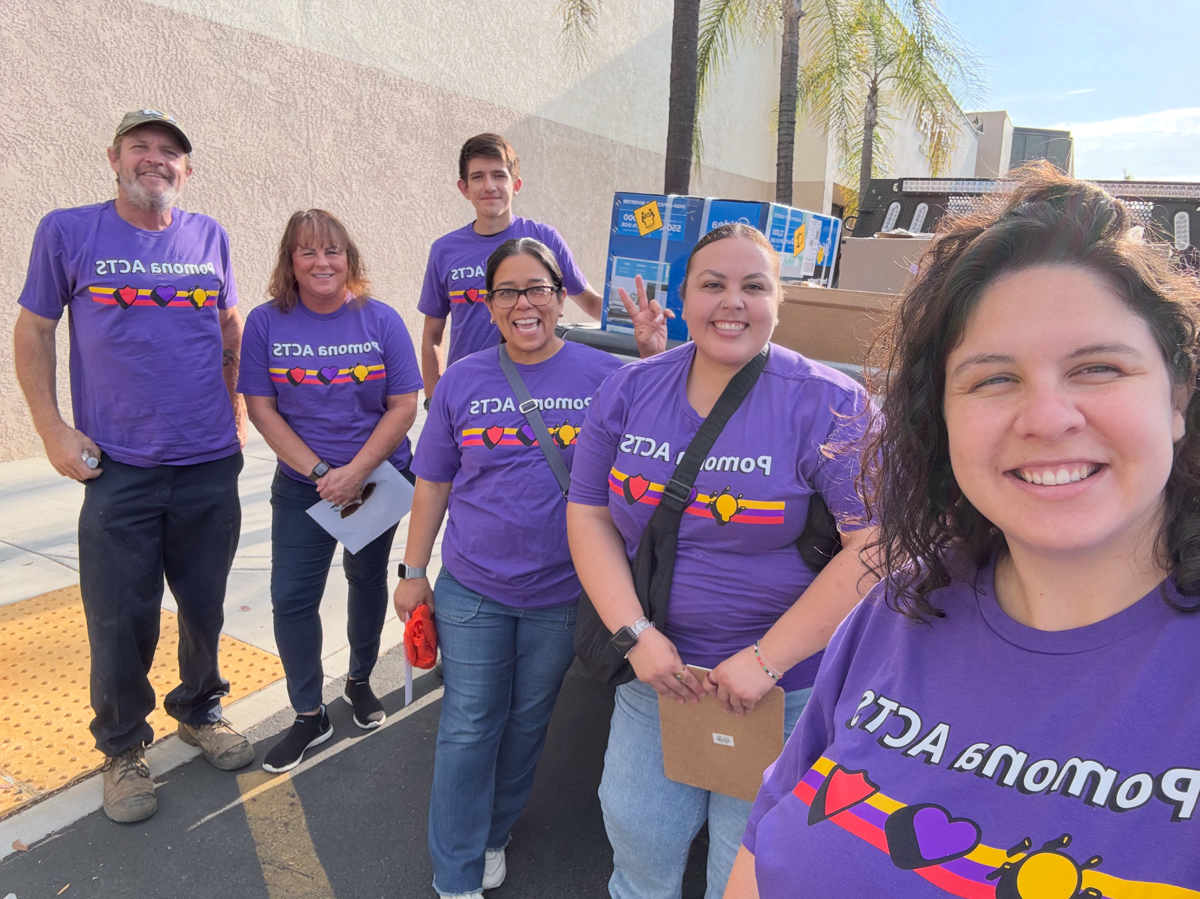

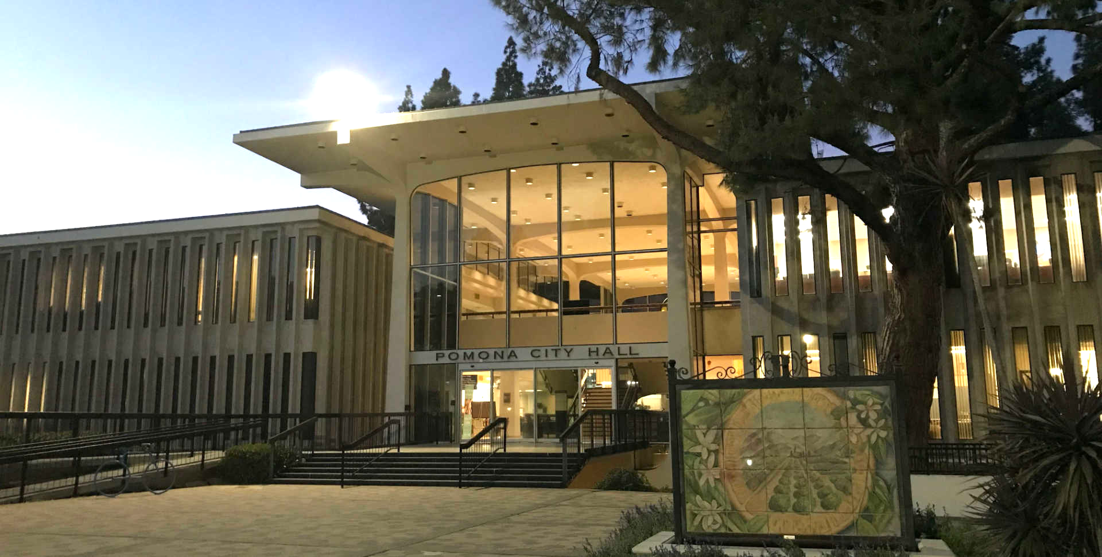

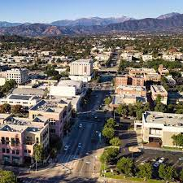
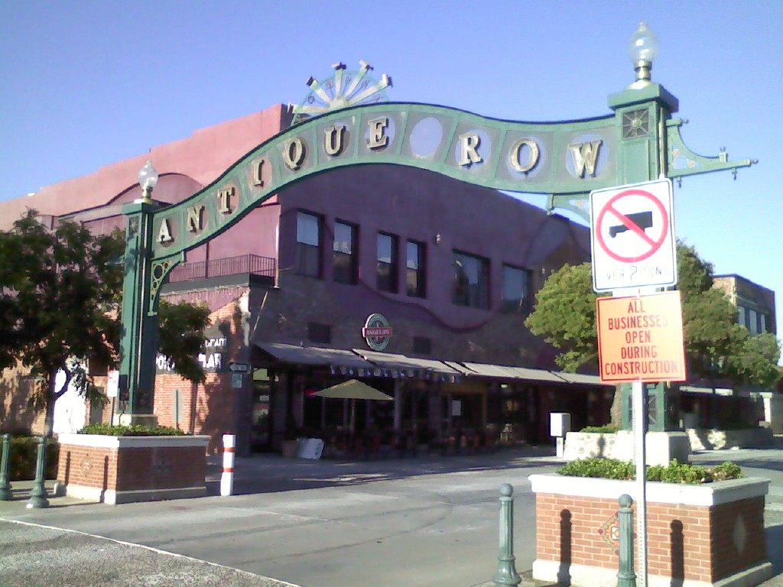
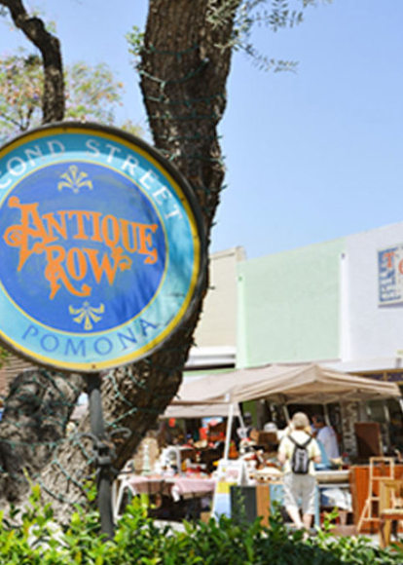

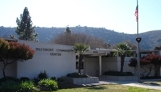
Pomona Activated for Community Transformation and Sustainability
Workforce Development Plan
The WDEOP will provide up to 75 participants with trainings to prepare clients for green careers, including solar installation and solar module construction, electric vehicle (EV) charging installation, e-bike building and maintenance, and provide wrap-around support and services to connect a target of 50% of participants to full-time employment.
Coordinate with stakeholders through quarterly advisory meetings and host 1 annual career fair.
Conduct outreach at 3 locations during 2 recruitment periods, with 5 social media posts per cycle.
Enroll and train up to 40 individuals in solar installation, 20 in solar production, 10 in EV installation, and 5 in bike maintenance, including Occupational Safety and Health Administration (OSHA) training and hands-on solar installation experience.
Coordination with local workforce and service providers
PomonaActs.org
@pomonaacts
hello@pomonaacts.org

Slide 15
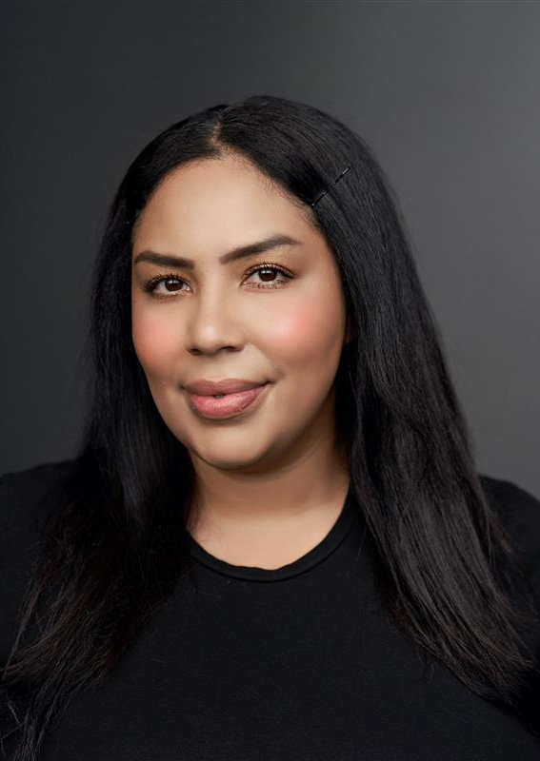
Falisha Lucas
Deputy Director, Tribal Affairs, CALSTART
Falisha Lucas is a geospatial expert and Deputy Director at CALSTART, leveraging over 15 years of experience in clean transportation, historical preservation, utilities, and conservation. With a background in Geography and GIS from the University of New Mexico and the University of Miami, she has spearheaded landmark mapping and transportation initiatives—from modeling sea-level rise to developing the nation’s first comprehensive park database.
At CALSTART, Falisha led the development of the Funding Finder, zero-emission pilot projects, and the creation of the utility and tribal affairs portfolio. Known for her practical leadership style, she is a dedicated environmental steward committed to advancing meaningful, steadfast change to Indian Country and underserved communities.

Slide 16
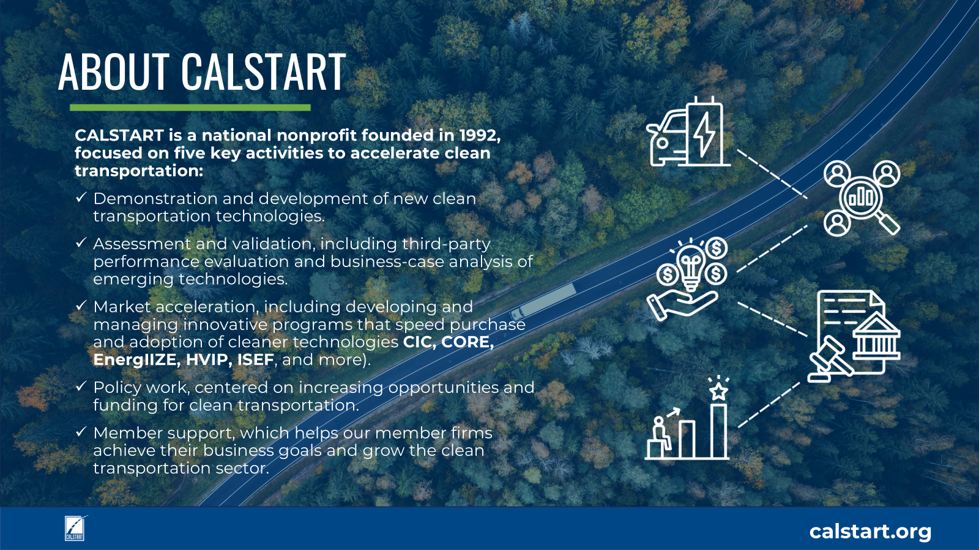
Pomona Activated for Community Transformation and Sustainability
Workforce Development Plan
The WDEOP will provide up to 75 participants with trainings to prepare clients for green careers, including solar installation and solar module construction, electric vehicle (EV) charging installation, e-bike building and maintenance, and provide wrap-around support and services to connect a target of 50% of participants to full-time employment.
Coordinate with stakeholders through quarterly advisory meetings and host 1 annual career fair.
Conduct outreach at 3 locations during 2 recruitment periods, with 5 social media posts per cycle.
Enroll and train up to 40 individuals in solar installation, 20 in solar production, 10 in EV installation, and 5 in bike maintenance, including Occupational Safety and Health Administration (OSHA) training and hands-on solar installation experience.
Coordination with local workforce and service providers
PomonaActs.org
@pomonaacts
hello@pomonaacts.org

Slide 17
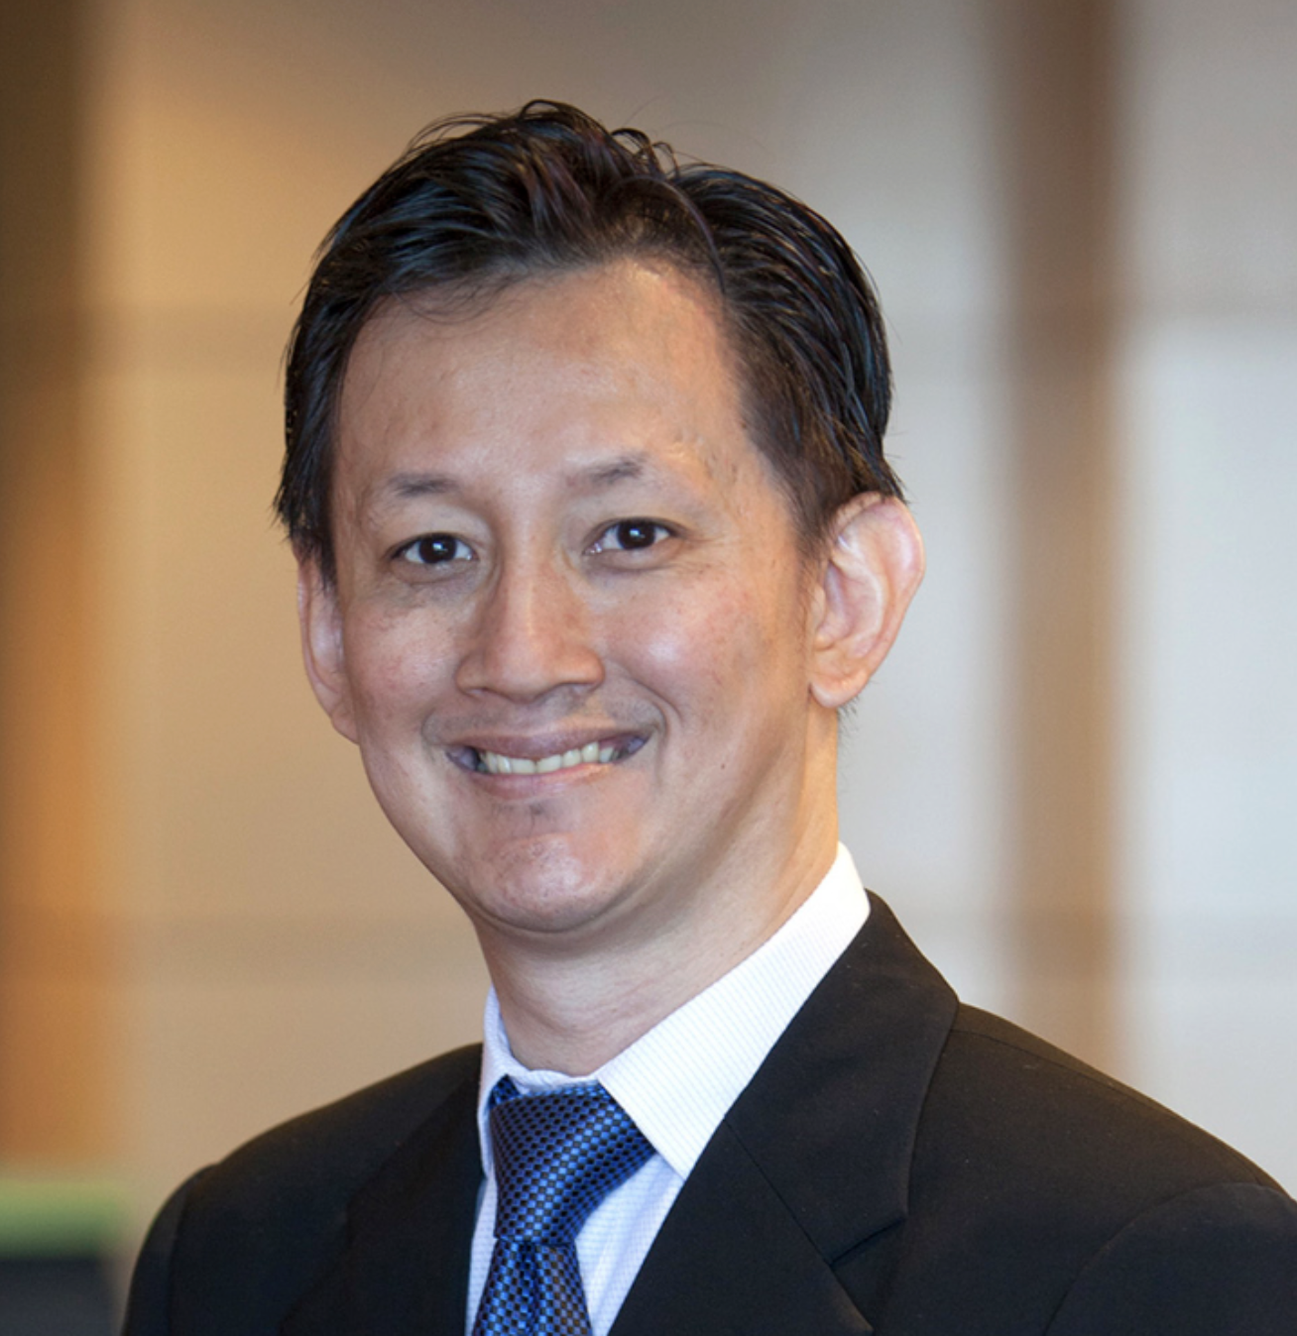
Eddie Santosa
Sustainability & Resilience Practice Lead, North America: West – Parsons
Adjunct Lecturer – Architecture – Cal Poly Pomona
Eddy Santosa is a global sustainability leader with 25 years of experience in high‑performance buildings and infrastructure, net‑zero strategies, climate‑responsive design, and embodied and life‑cycle carbon. He is widely recognized for his leadership in green building and LEED implementation, having delivered more than 300 high‑performance projects, including large‑scale infrastructure, transit systems, and agency capital programs where sustainability, resilience, and carbon accountability are applied at billion‑dollar scale. Additionally, he also teaches Environmental Control as an adjunct lecturer in architecture at California State Polytechnic University, Pomona. His portfolio includes net zero buildings, major airport terminals, rail and transit facilities, water infrastructure, and large public–private partnership campus and industrial developments. He has led decarbonization planning for complex urban districts and advises on campus‑ and portfolio‑scale sustainability strategies.
Eddy serves as Vice Chair of the LA Metro Sustainability Council, advising on sustainability policy and implementation. He has chaired the AIA National Building Performance Knowledge Community and served on the IBPSA‑US board. He is a voting member of ASHRAE SPC 209‑2018R, a LEED Pro Reviewer, and a former LEED Energy & Atmosphere Technical Advisory Group member. He frequently presents at national and international conferences and has authored numerous publications on sustainability, building performance, and carbon reduction.

Slide 18
Q&A

Slide 19
Program Spotlight: Dr Mary Anne Akers, Dean of the College of Environmental Design,
Cal Poly Pomona

Slide 20
Closing Remarks - Ben Stapleton

Slide 21

Meeting Survey
Notes:
https://form.jotform.com/260745474929167

Slide 22
SoCalREN Q4 2025 Regional Workforce Alliance Meeting
Thank You!

