Slide 1
SoCalREN Q4 2025 Regional Workforce Alliance Meeting
December 17, 2025
Woodbury University, Burbank, CA

Slide 2

Agenda
11:30 AM - 12 PM - Welcome and Networking Lunch
11:45 AM Welcome: Minh Le, General Manager, Internal Services Department, LA County
11:50 AM Keynote Speaker: CA Assembly Member Nick Schultz (D-District 44)
12:10 PM - 1:30 PM - Featured Panel Discussion: SoCal's Talent Pipeline: Converting Entertainment Skill Sets into Energy Sector Opportunities
Kent Hayward, California State University Long Beach, and a co-founder of the Green Film School Alliance
DeJon Ellis Jr, Business Manager, IATSE Local 80
Adam Ereth, Ereth Environmental and co-founder of SPEC
Justin Broederdorf, Vice President, Facilities & Backlot Operations at Sony Pictures Entertainment
1:30 PM - 1:40 PM - Program Spotlight: Jennifer Peterson, Professor of Filmmaking and Heather Flood, Dean, School of Architecture, Woodbury University
1:40 PM - 1:45 PM - Closing Remarks and Networking
2 PM - 2:30 PM - Optional Tour - Woodbury University Solar Home

Slide 3
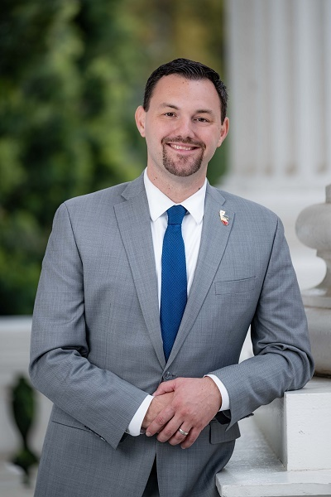
Nick Schultz
Assemblymember California Assembly District 44.
Glendale, and surrounding communities). Elected in 2024, he was promptly tapped by Speaker Robert Rivas to serve as Chair of the Assembly Public Safety Committee. As Chair, he directs the committee's focus toward increasing community safety for all Californians and building a more equitable criminal justice system.
A former Deputy Attorney General with the California Department of Justice, Schultz prosecuted public corruption, human trafficking, and financial crimes, and established an innovative Post-Conviction Review Unit to address wrongful convictions.
Building on his public service career, Schultz was elected to the Burbank City Council in 2020, later serving as Mayor. During his tenure, he championed policies to combat homelessness, reduce crime, achieve carbon neutrality, and approve over 1,000 new units of low-income housing.
Assemblymember Schultz is the first in his working-class family to graduate from college, holding both a bachelor’s and law degree from the University of Oregon. He also serves as Policy Chair of the Progressive Legislative Caucus and is a member of the Assembly Committees on Budget, Natural Resources, and Utilities and Energy. He resides in Burbank with his wife, Allie, and their two children.

Slide 4
SoCal's Talent Pipeline: Converting Entertainment Skill Sets into Energy Sector Opportunities

Slide 5
Meet the Experts!
Moderator - Tessa Charnofsky, Program Manager, SoCalREN
Panelists:
Kent Hayward, California State University Long Beach, and a co-founder of the Green Film School Alliance
DeJon Ellis Jr, Business Manager, IATSE Local 80
Adam Ereth, PhD Ereth Environmental and co-founder of SPEC
Justin Broederdorf, Vice President, Facilities & Backlot Operations at Sony Pictures Entertainment

Slide 6
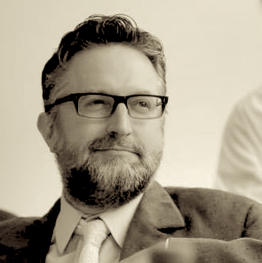
Kent Hayward
Filmmaker, Professor of Production
Kent Hayward is a filmmaker, professor of production at California State University Long Beach, and a co-founder of the Green Film School Alliance. His book Green Filmmaking: A Guide to Sustainable Movie Production (Routledge, 2025) is the first text of its kind for film and media production. He earned his BA at the University of Wisconsin-Madison and his MFA at the California Institute of the Arts. Previously, Hayward worked in visual effects and editorial on films including Inception, Terminator 3, and TV shows for NBC Universal, SyFy, and Lifetime. Hayward's projects include Lunar Estates, Homestead Artifact, August, and Sunset to Sunset. Currently, Hayward is working on an essay film called Footprint, about what we leave behind.

Slide 7
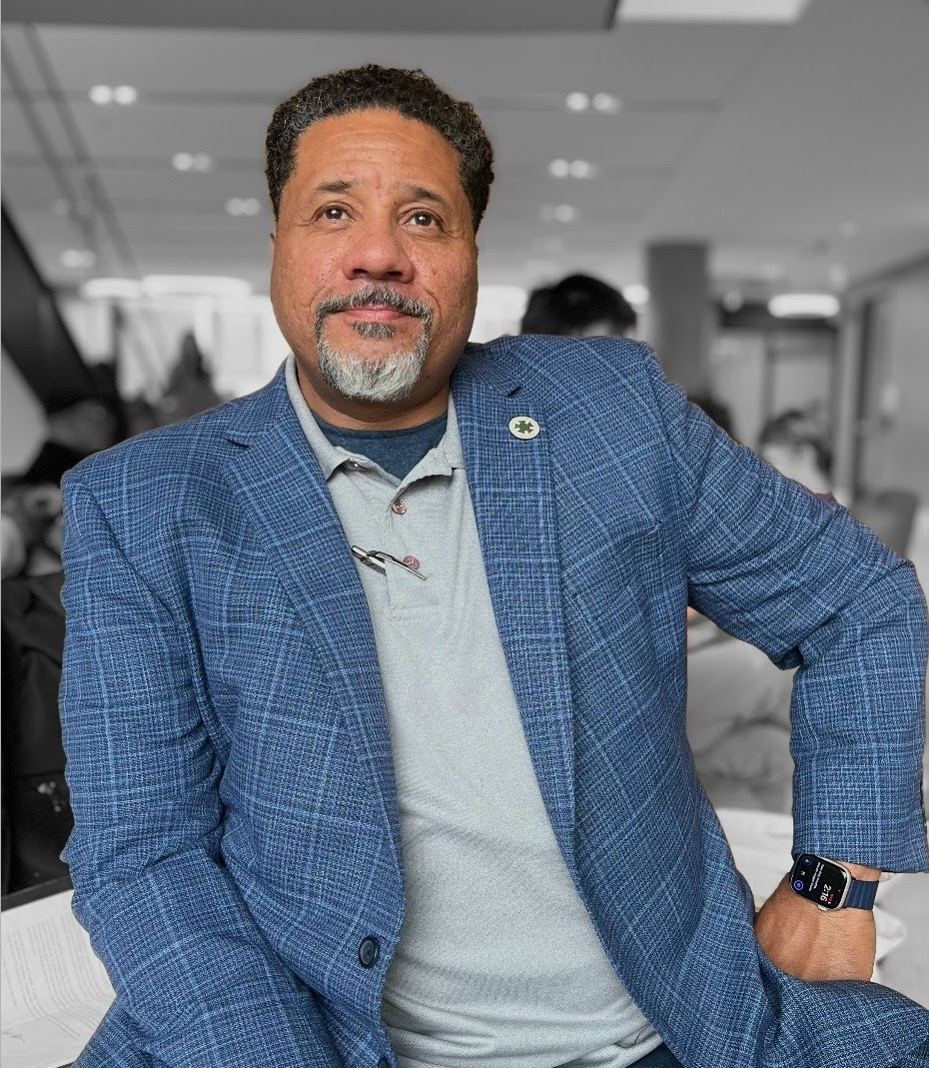
DeJon Ellis Jr.
Business Manager, IATSE Local 80
Los Angeles native DeJon Ellis Jr. has been a Member of IATSE Local 80 for 30 years and is currently serving his 2nd term as its’ Business Manager representing Grips, Crafts Service and Medics in the Film/Television Industry. He worked in the field as a Grip for 26 years and has worked on various projects, from feature films to prime-time television and music videos.
Known for his no-nonsense approach and unwavering commitment to his membership, he is a steady advocate for Local 80 members navigating a rapidly changing Industry landscape. DeJon continues to advocate for Local 80 members as the industry evolves, ensuring their skills and contributions remain essential in a more sustainable future.

Slide 8
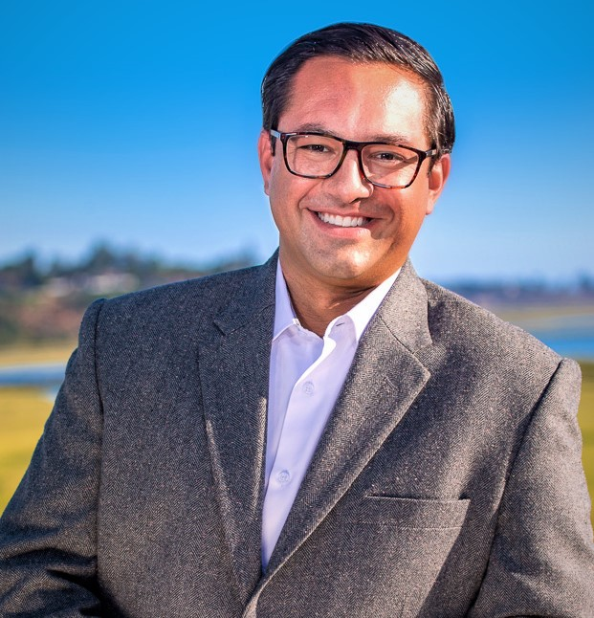
Adam Ereth, PhD
Founder, Ereth Environmental + Executive Director, Someone Cares (OC)
Adam leads Ereth Environmental LLC, a California registered environmental consulting and management firm specialized in environmental education and curriculum development; environmental program development and strategic planning; non-profit impact and systems change; corporate and government climate change/sustainability action plans; and sustainable production planning and executive training for the entertainment industry. Adam’s career demonstrates a dedication to high-impact roles and projects, including:
Non-profit Executive Director with recognition as 2021 “Outstanding Non-Profit” by the California State Assembly 74th District, and 2022 non-profit recognition from the CA State Senate 37th District,
Environmental Health Manager for State Air Quality programs, including being awarded South Carolina’s first U.S. Department of Education Green Ribbon School designation,
Orange County Board of Supervisors Policy Advisor for Sustainability and Transportation,
Author of the Orange County Climate and Sustainability Action Plan framework, and co-author of the John Wayne Airport “Fly Friendly” emissions reduction program,
Author of “Economic Development, Political Processes and Climate Change Adaptation in the Solomon Islands”
Mayor’s appointee and Chair of the Costa Mesa Planning Commission,
Professor of Geographic Sciences at several colleges,
Flagship Director of Sustainability and Engagement for the Producers Guild of America, and more.

Slide 9
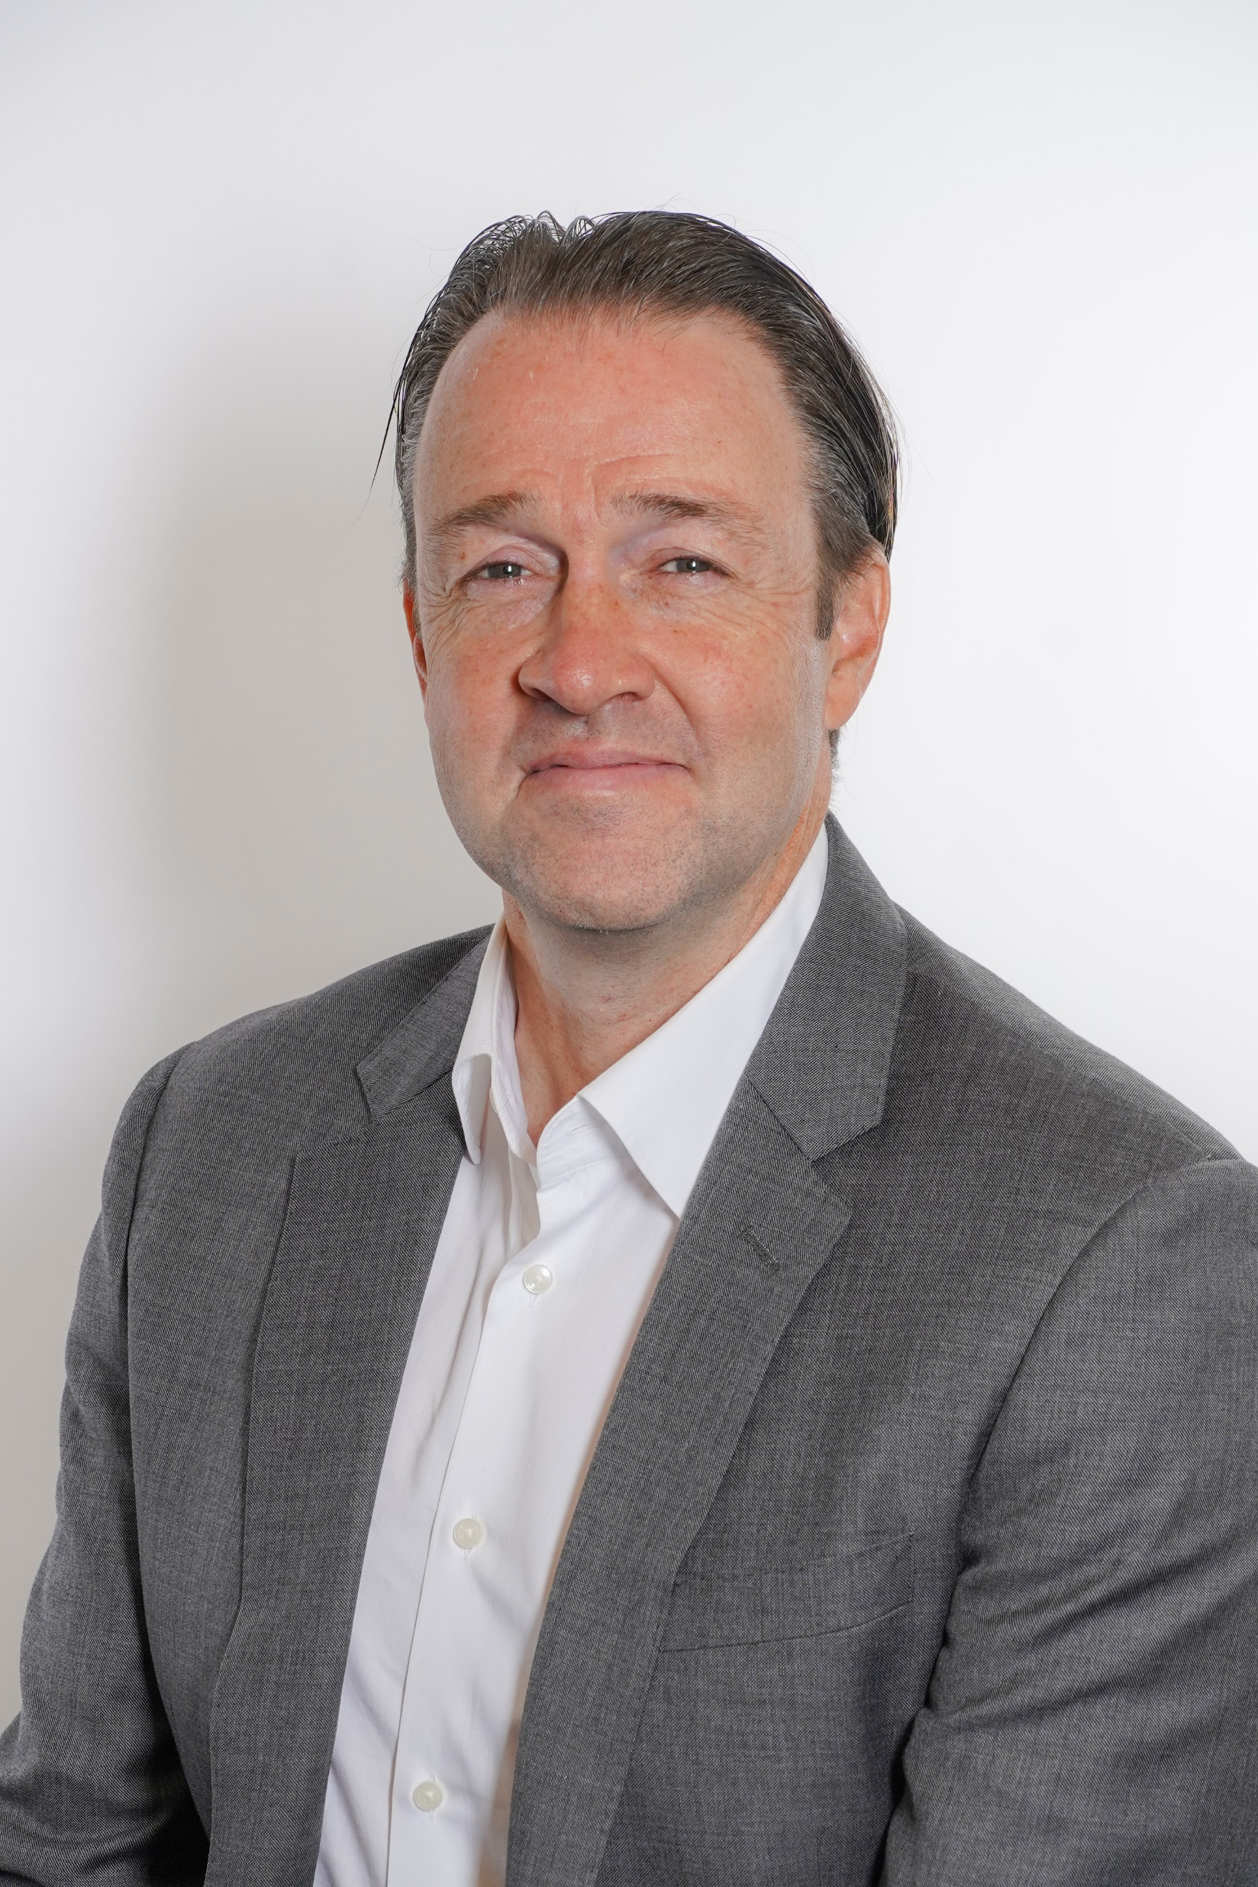
Justin Broederdorf,
Vice President, Facilities & Backlot at Sony Pictures Entertainment
Justin serves as the Vice President of Facilities & Backlot Operations at Sony Pictures Entertainment. In this high-level operational role, he is responsible for managing the massive physical infrastructure and real estate of the studio, which includes sound stages, offices, and utility systems.
Justin possesses:
9 years experience between Sony & Paramount Movie/Television Studios
12 years experience in Manufacturing
Focus areas of Operations, Maintenance, Capital Projects, and Energy Reduction

Slide 10
Q&A

Slide 11
Program Spotlight - Woodbury University

Slide 12
Closing Remarks - Ben Stapleton

Slide 13
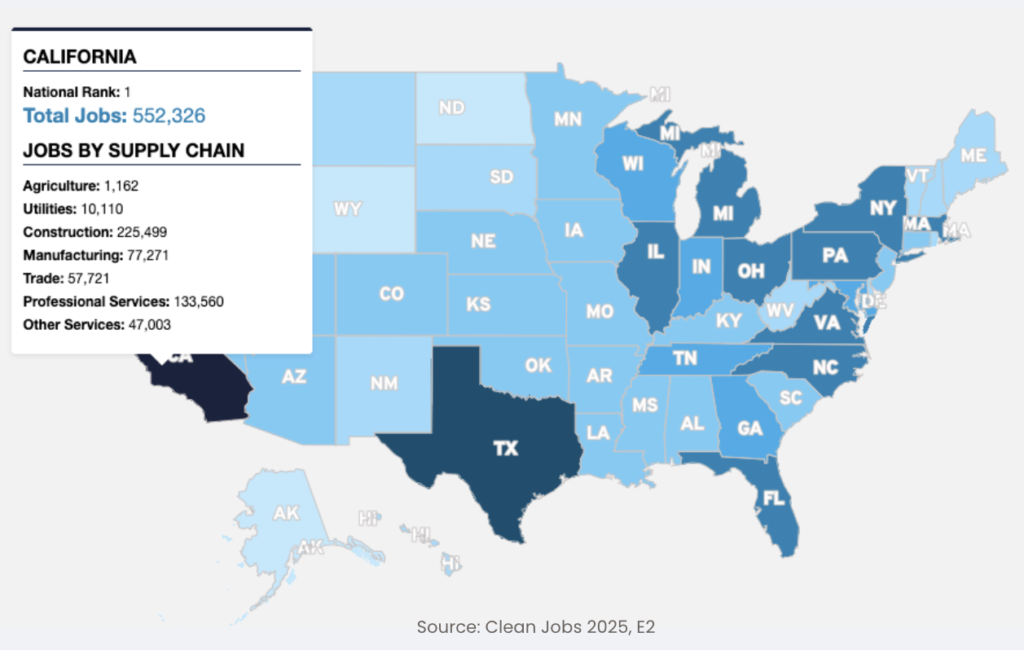
High Demand Skills and Knowledge
High Demand Skills and Knowledge at the Intersection of Energy and Entertainment
Green Building Science
Facilities and Building Operations
HVAC Installation and Maintenance
Energy Modeling
Sustainability Planning
Procurement
Energy Auditing
Lighting Installation and Maintenance
Code Compliance
Waste Management
Coordination
Project Management
Data Collection and Analysis
Storytelling with Data
Electrical Technicians

Slide 14
Training Resources for Transitioning Workers
SoCalREN’s "Green Path Careers": Provides technical training, industry certifications, and paid work experience in energy efficiency (HVAC, lighting, and retrofits). Carlos Paez GPC Program Manager cpaez@emeraldcities.org
SCE Energy Education Center (Irwindale): Free classes and workshops on high-efficiency technologies, heat pump water heaters, and advanced lighting systems.
Energy Code Ace: Provides free, highly specific training on Title 24 (California’s energy code) and Title 20. This is essential for anyone looking to become a HERS Rater or compliance inspector.
USGBC-CA (U.S. Green Building Council, California):
Green Building Corps: A structured internship/mentorship program for emerging or transitioning professionals.
Certificate Programs: Offers numerous certificate programs ranging from Foundations of Green Building to
LACI (Los Angeles Cleantech Incubator): Offers multi-tiered workforce training including:
EVSE Technician Training: For electric vehicle charging station maintenance.
Microgrid Maintenance Fellowships: Specialized training in advanced grid technology.
GRID Alternatives (Greater Los Angeles): Offers Installation Basics Training (IBT) program that provides hands-on solar installation experience on real job sites.
Union Training, Community Colleges, Community Based Organizations, Economic Development Orgs

Slide 15
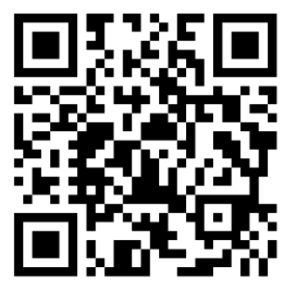


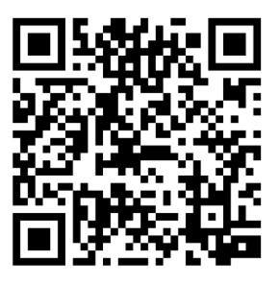


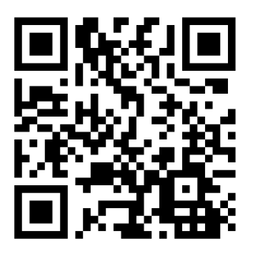

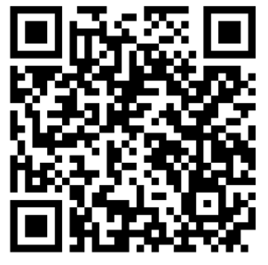


Green Job Boards
Who’s Hiring?
Los Angeles Department of Water and Power (Techs, Craft Helpers, Retrofit Carpenters)
SoCal Edison (Techs, Line Clearance, Electrical)
Chargepoint (EV Installers, Maintenance Techs)
Trane (HVAC Techs, Controls Techs)
Baker Electric (PV Installers, Battery Storage)
Notes:
Employer Type
Representative Companies
Typical Skilled Trade Roles
Utilities
LADWP, SoCalEdison
Line Workers, Substation Techs, Craft Helpers
EV Infrastructure
Tesla, Electrify America, ABM
EV Charging Installers, Maintenance Techs
HVAC/Mechanical
ACCO Engineered Systems, Trane
HVAC Techs, Controls Techs, Pipefitters
Solar/Storage
GRID Alternatives, Sunrun, Baker Electric
PV Installers, Battery Storage Techs
Weatherization
PACE, Maravilla Foundation
Weatherization Techs, Retrofit Carpenters

Slide 16
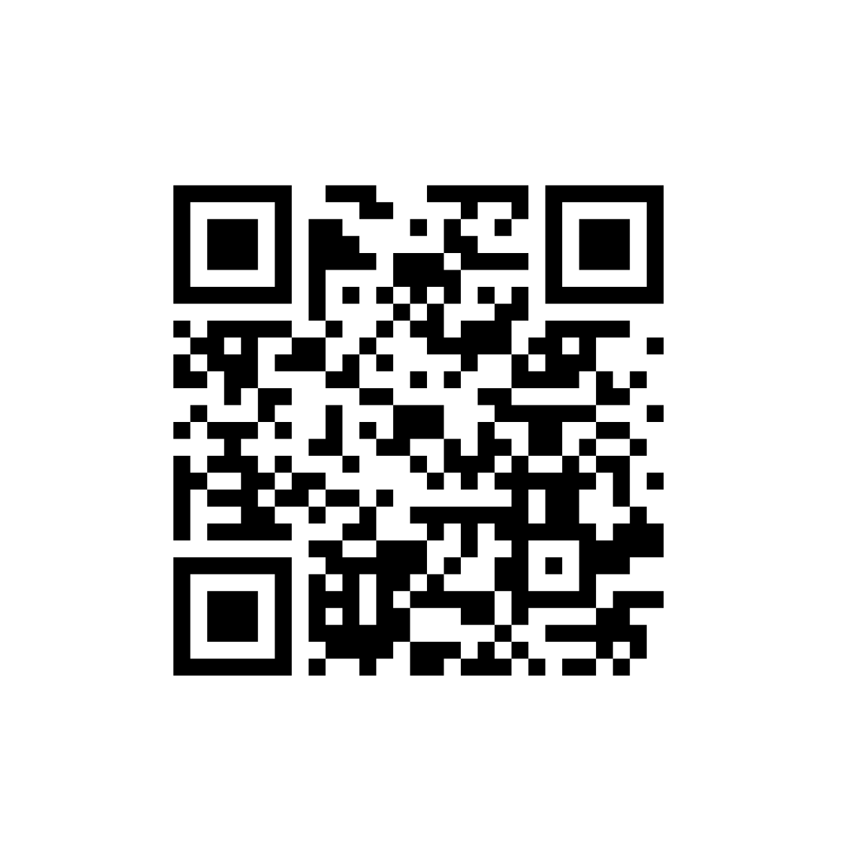
Meeting Survey
Notes:
https://form.jotform.com/253176587105158

Slide 17
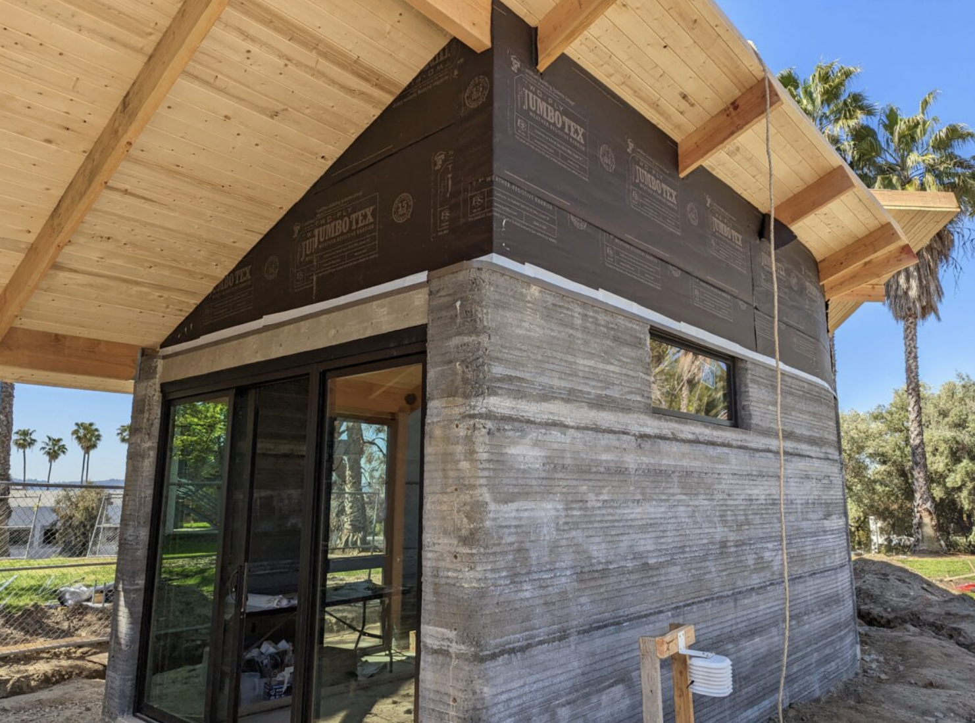
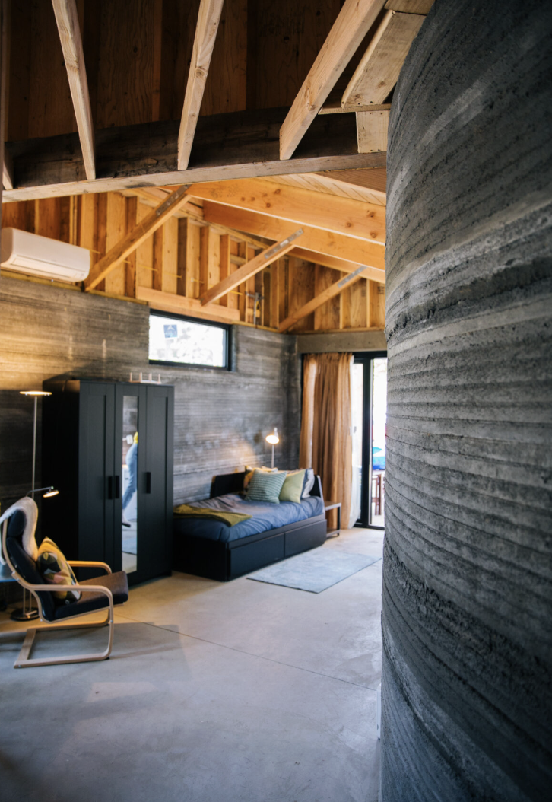
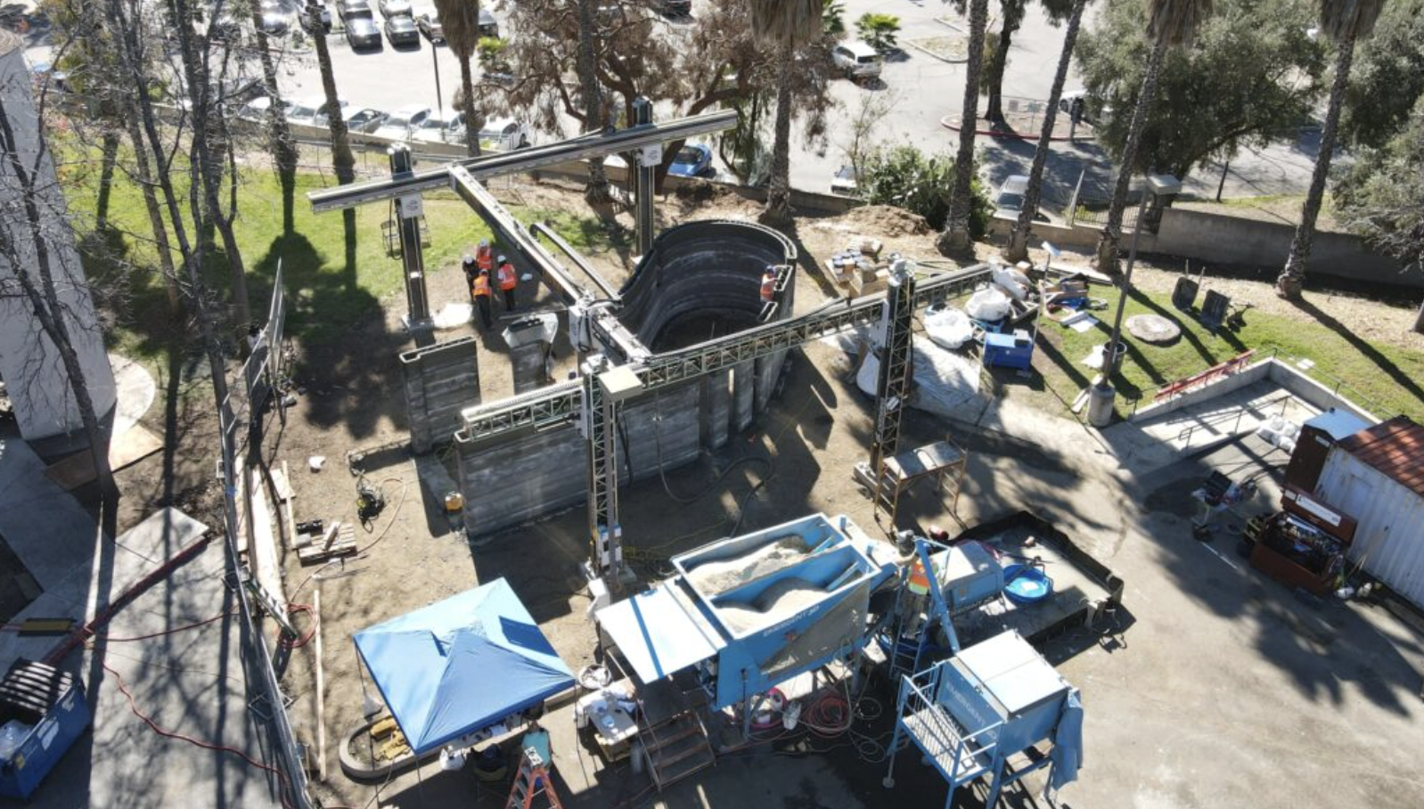
Woodbury University
Solar Futures Home Tour

Slide 18
SoCalREN Q4 2025 Regional Workforce Alliance Meeting
Thank You!

